Slide 1
PET328
COMPUTER APPLICATIONS IN PETROLEUM ENGINEERING

Slide 2


PET328: COMPUTER APPLICATIONS IN PETROLEUM ENGINEERING
(With Python Programming)
Olatunde O. Mosobalaje (PhD)
Department of Petroleum Engineering,
Covenant University, Ota
Nigeria

Slide 3


PET 328: Computer Applications in Petroleum Engineering – with Python Programming Dr. Mosobalaje, O. O.
OUTLINE
Preambles
The Appetizer
The Toolbox
The Embedded Course
Introduction to Computer Programming
Getting Started with Python
Basic Python Objects
Conditional Execution
Repeated Execution
Functions
Python Data Structures
Strings
Lists
Tuples
Dictionaries
Some Python Libraries
NumPy
Matplotlib
Pandas
Scikit-learn
Application Projects
Oil Reservoir Volumetrics
Material Balance Analysis
PVT Properties

Slide 4
PET 328: Computer Applications in Petroleum Engineering – with Python Programming Dr. Mosobalaje, O. O.
PREAMBLES
The Appetizer – a presentation
ACQUIRING NASCENT SKILLS FOR EMERGING OIL AND GAS OPPORTUNITIES: DATA ANALYTICS, MACHINE LEARNING AND ARTIFICIAL INTELLIGENCE

Slide 5
PET 328: Computer Applications in Petroleum Engineering – with Python Programming Dr. Mosobalaje, O. O.
PREAMBLES
The Toolbox
For this course, the following tools would be needed:
Python 3
Python Integrated Development and Learning Environment (IDLE)
Git and GitHub

Slide 6
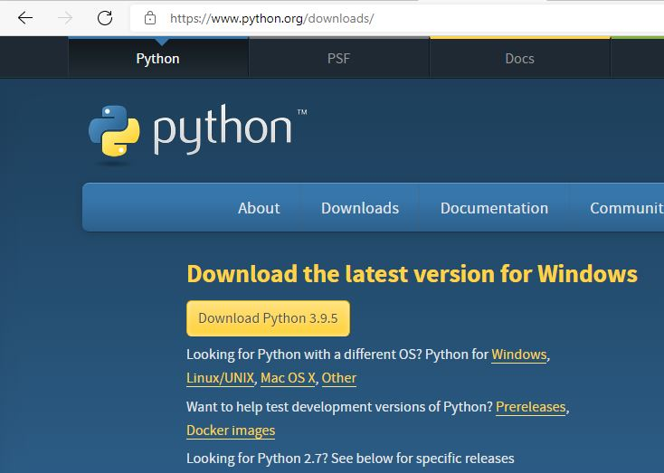
PET 328: Computer Applications in Petroleum Engineering – with Python Programming Dr. Mosobalaje, O. O.
PREAMBLES
The Toolbox
Installing Python 3
To install the latest release of Python 3, go to Python download website: https://www.python.org/downloads/

Slide 7
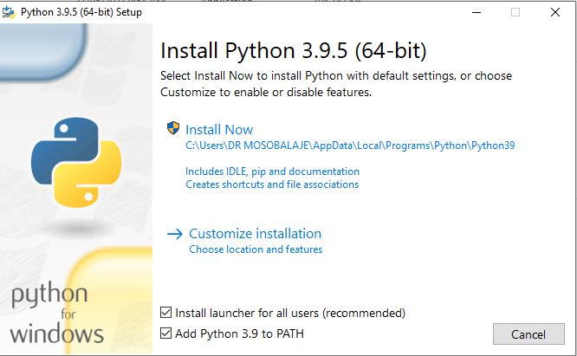
PET 328: Computer Applications in Petroleum Engineering – with Python Programming Dr. Mosobalaje, O. O.
PREAMBLES
The Toolbox
Installing Python 3
Launch the downloaded executable file by double-clicking the file in your download folder.
Follow the steps as the installer leads
Click on the default installation option.
Ensure to check the Add Python 3.9 to PATH

Slide 8
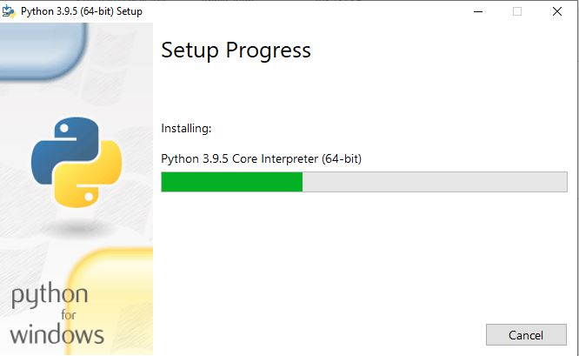
PET 328: Computer Applications in Petroleum Engineering – with Python Programming Dr. Mosobalaje, O. O.
PREAMBLES
The Toolbox
Installing Python 3

Slide 9
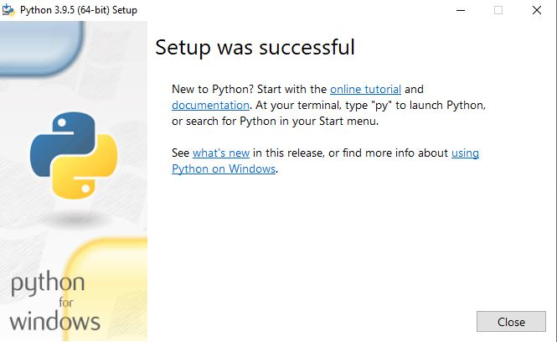
PET 328: Computer Applications in Petroleum Engineering – with Python Programming Dr. Mosobalaje, O. O.
PREAMBLES
The Toolbox
Installing Python 3
Click the close button when the installation is completed

Slide 10
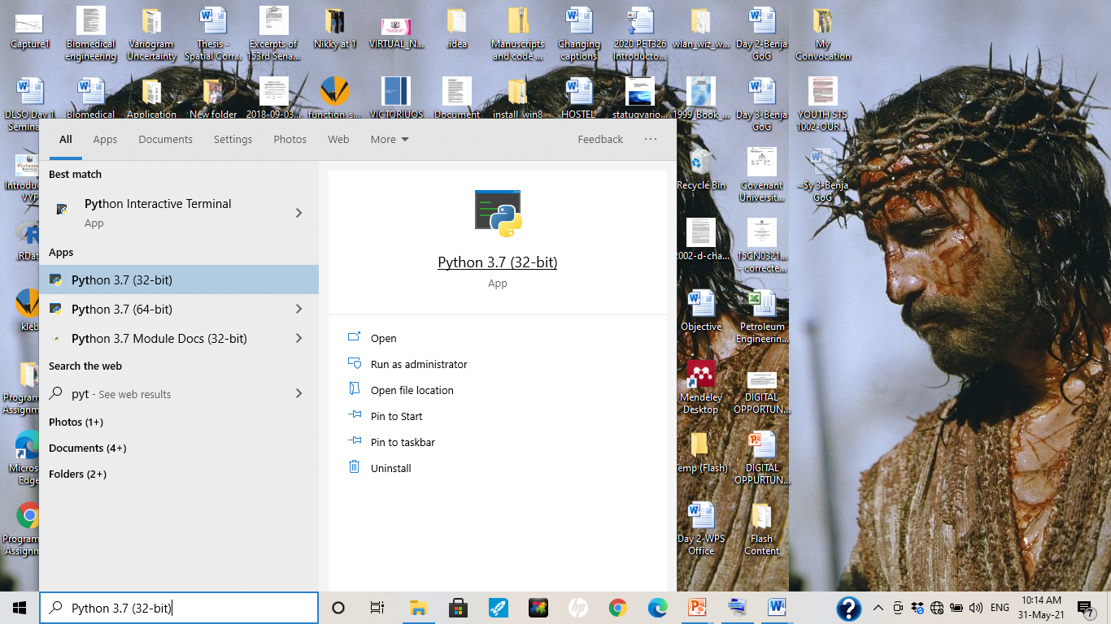
PET 328: Computer Applications in Petroleum Engineering – with Python Programming Dr. Mosobalaje, O. O.
PREAMBLES
The Toolbox
Launching Python 3
Simply type Python into the Start Menu search box and click the Python program.

Slide 11
PET 328: Computer Applications in Petroleum Engineering – with Python Programming Dr. Mosobalaje, O. O.
PREAMBLES
The Toolbox
Launching Python 3
Simply type Python into the Start Menu search box and click the Python program.

Slide 12
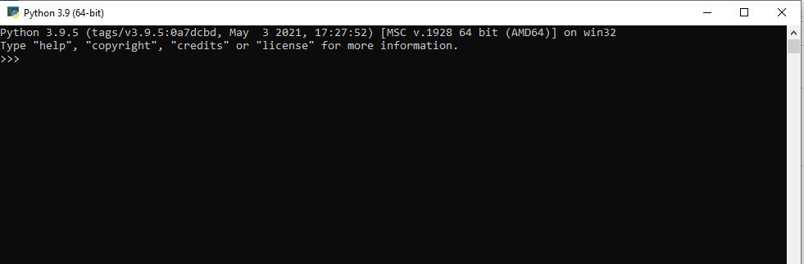
PET 328: Computer Applications in Petroleum Engineering – with Python Programming Dr. Mosobalaje, O. O.
PREAMBLES
The Toolbox
Launching Python 3

Slide 13
PET 328: Computer Applications in Petroleum Engineering – with Python Programming Dr. Mosobalaje, O. O.
PREAMBLES
The Toolbox
Python IDLE
Now, the Python DOS-like environment seems boring. Good enough, we will typically not be working on that platform; rather we will interact with Python from a platform known as Interactive Development and Learning Environment (IDLE)

Slide 14
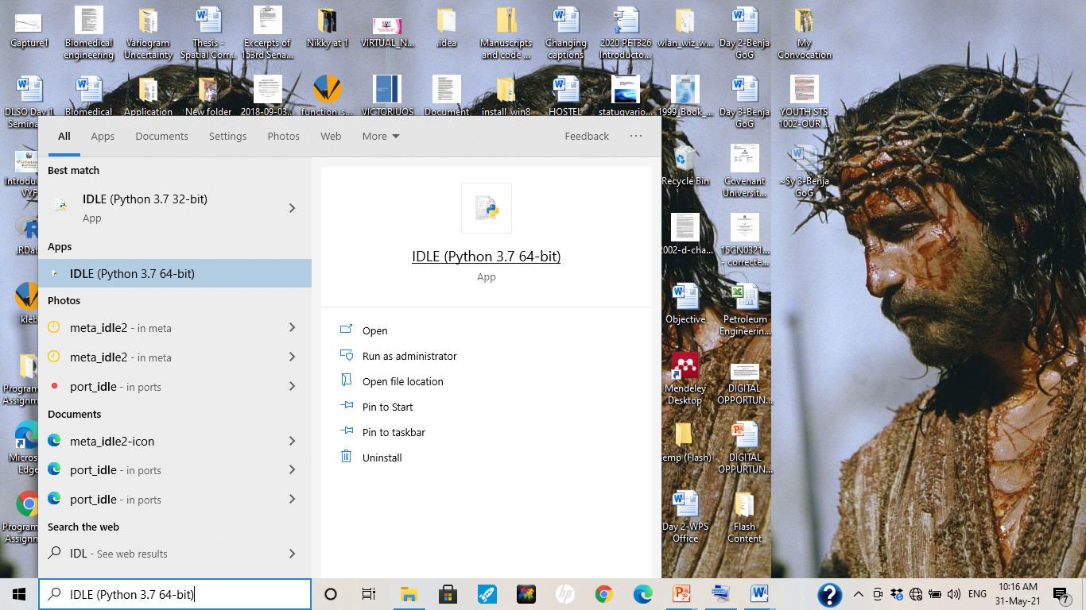
PET 328: Computer Applications in Petroleum Engineering – with Python Programming Dr. Mosobalaje, O. O.
PREAMBLES
The Toolbox
Python IDLE
To launch IDLE, simply type IDLE into the Start Menu search box and click on the IDLE program.

Slide 15
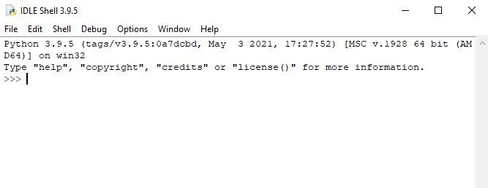
PET 328: Computer Applications in Petroleum Engineering – with Python Programming Dr. Mosobalaje, O. O.
PREAMBLES
The Toolbox
Python IDLE

Slide 16
PET 328: Computer Applications in Petroleum Engineering – with Python Programming Dr. Mosobalaje, O. O.
PREAMBLES
The Toolbox
Python IDLE
There are two ways by which you could communicate with Python from the IDLE environment:
Interactive
From a file (script)

Slide 17
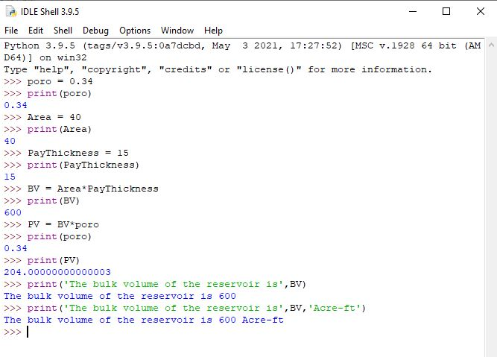
PET 328: Computer Applications in Petroleum Engineering – with Python Programming Dr. Mosobalaje, O. O.
PREAMBLES
The Toolbox
Communicating with Python interactively
In this case, you type in Python command (one at a time) into the console. Each command get executed once the ‘Enter’ key is pressed. Depending on the command, results may be displayed on the console once the command is executed.

Slide 18
PET 328: Computer Applications in Petroleum Engineering – with Python Programming Dr. Mosobalaje, O. O.
PREAMBLES
The Toolbox
Communicating with Python interactively
In this case, you type in Python command (one at a time) into the console. Each command get executed once the ‘Enter’ key is pressed. Depending on the command, results may be displayed on the console once the command is executed.

Slide 19
PET 328: Computer Applications in Petroleum Engineering – with Python Programming Dr. Mosobalaje, O. O.
PREAMBLES
The Toolbox
Communicating with Python from a file
In this case, you type in Python commands (all at a time) into a text file editor (code editor). The commands don’t get executed as they are being typed. Rather, they get executed (sequentially) when submitted as a whole to the Python interpreter.

Slide 20
PET 328: Computer Applications in Petroleum Engineering – with Python Programming Dr. Mosobalaje, O. O.
PREAMBLES
The Toolbox
Communicating with Python from a file
Any text editor program could be used for this purpose, as long as the file is saved as a .py file.
Good, Python has an in-built text editor for this purpose.

Slide 21
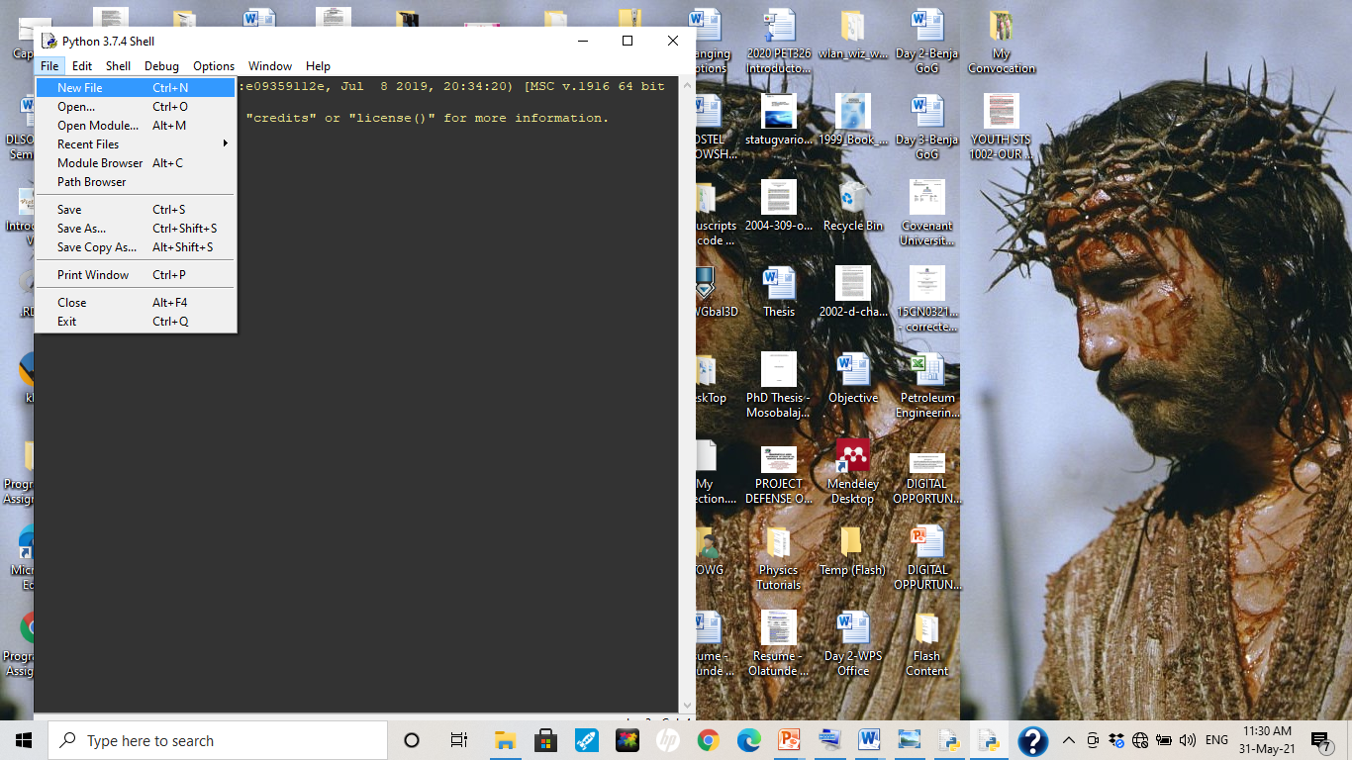
PET 328: Computer Applications in Petroleum Engineering – with Python Programming Dr. Mosobalaje, O. O.
PREAMBLES
The Toolbox
Communicating with Python from a file
To launch Python’s in-built code editor, just click on the File menu and choose New File.

Slide 22
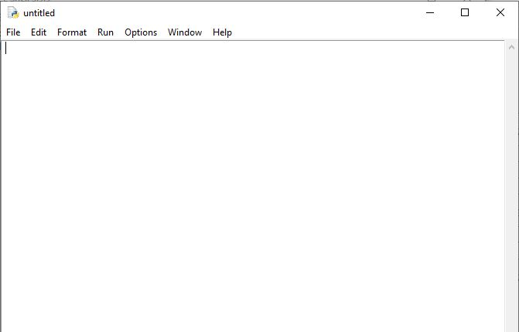
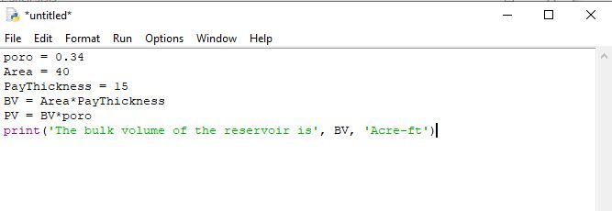
PET 328: Computer Applications in Petroleum Engineering – with Python Programming Dr. Mosobalaje, O. O.
PREAMBLES
The Toolbox
Communicating with Python from a file
Once the editor is opened, you can type in your lines of codes.

Slide 23
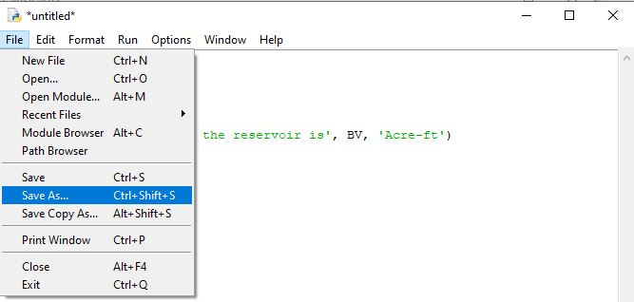
PET 328: Computer Applications in Petroleum Engineering – with Python Programming Dr. Mosobalaje, O. O.
PREAMBLES
The Toolbox
Communicating with Python from a file
Before submitting the lines of codes in the code editor to the Python interpreter, you need to save the editor file.
To save, simply go the File menu and choose Save As

Slide 24
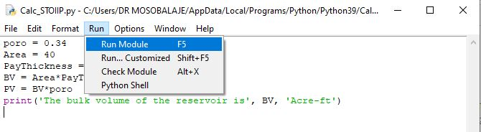
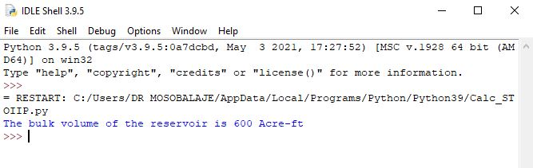
PET 328: Computer Applications in Petroleum Engineering – with Python Programming Dr. Mosobalaje, O. O.
PREAMBLES
The Toolbox
Communicating with Python from a file
Once the file (script) is saved, the code lines can be submitted to the Python interpreter by choosing item ‘Run Module’ in the Run menu.
The output of the code execution (if any) is subsequently displayed on the Python console.

Slide 25



PET 328: Computer Applications in Petroleum Engineering – with Python Programming Dr. Mosobalaje, O. O.
PREAMBLES
The Toolbox
Git and GitHub
Git is an open source version control software.
What is Version Control?
Version control (VC) is a system used for keeping track of changes made to a file over time. As the changes are made, the system records and save the state of the file at instances indicated by the user. Such user can revert back to a previous version of the file when necessary.
Essentially, the VC system keeps the latest version of the file but also keeps a record of all changes between all versions.

Slide 26
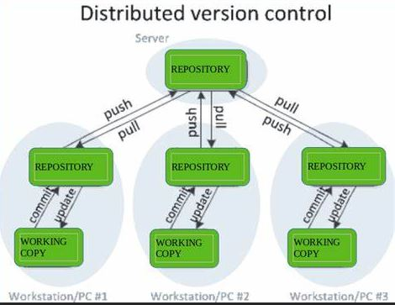
PET 328: Computer Applications in Petroleum Engineering – with Python Programming Dr. Mosobalaje, O. O.
PREAMBLES
The Toolbox
Git and GitHub
And, there is something called Distributed Version Control (DVC)
What is Distributed Version Control?
Typically, real life projects (including oilfield digital projects) are done by teams whose members need to collaborate – work together on same files. Individual members of the team can make changes to such shared files. There is therefore a need to make such file available on a central server and to keep track of the following:
who made what change?
When was the change made?
Why was the change made?

Slide 27
PET 328: Computer Applications in Petroleum Engineering – with Python Programming Dr. Mosobalaje, O. O.
PREAMBLES
The Toolbox
Git and GitHub
And, there is something called Distributed Version Control (DVC)
What is Distributed Version Control?
A version control system that also comes with the capabilities for collaboration among several people is known as Distributed Version Control system.
Git is a version control system – locally hosted on your system.
GitHub is an online platform that interfaces with Git, hosting your files on remote servers thereby making them available for collaboration with others.

Slide 28
PET 328: Computer Applications in Petroleum Engineering – with Python Programming Dr. Mosobalaje, O. O.
PREAMBLES
The Toolbox
Git and GitHub
In this course, we shall be working as a team, therefore, both Git and GitHub are part of tools we shall be using. Essentially, submissions to some assignments shall be in the form of code file editing and sharing between students and the Course Instructor.

Slide 29
PET 328: Computer Applications in Petroleum Engineering – with Python Programming Dr. Mosobalaje, O. O.
PREAMBLES
Assignment 1
Get the following tools ready on your PC:
Git - install
A user account on github.com
GitHub desktop - install

Slide 30

PET 328: Computer Applications in Petroleum Engineering – with Python Programming Dr. Mosobalaje, O. O.
PREAMBLES
The Embedded Course
A Coursera course is embedded into this course (PET328). It is compulsory that all students completes the Coursera course as it is part of the assessment items in PET328.

Slide 31

PET 328: Computer Applications in Petroleum Engineering – with Python Programming Dr. Mosobalaje, O. O.
PREAMBLES
The Embedded Course
The embedded course is titled ‘Programming for Everybody (Getting Started with Python).
The course is offered by University of Michigan.

Slide 32
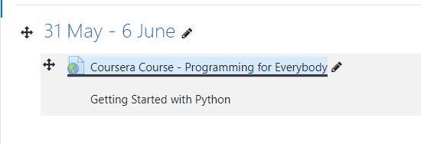
PET 328: Computer Applications in Petroleum Engineering – with Python Programming Dr. Mosobalaje, O. O.
PREAMBLES
The Embedded Course
The link to the embedded course has been added to the PET328 course site on Moodle.
To enroll for the Coursera course, simply click on the link.

Slide 33

PET 328: Computer Applications in Petroleum Engineering – with Python Programming Dr. Mosobalaje, O. O.
PREAMBLES
The Embedded Course

Slide 34

PET 328: Computer Applications in Petroleum Engineering – with Python Programming Dr. Mosobalaje, O. O.
PREAMBLES
The Embedded Course
When you complete the course, you are awarded a certificate of completetion!!!

Slide 35
PET 328: Computer Applications in Petroleum Engineering – with Python Programming Dr. Mosobalaje, O. O.
PREAMBLES
Introduction to Computer Programming
Analogy: Programming language vs. Natural language
There is a striking similarity between learning programming language and learning natural language. In both cases, the process is thus:
learn the vocabulary and the grammar – spell words, construct sentences etc.
Communicate
natural language: use words, sentences, paragraphs to communicate an idea
Programming language: use keywords, variables, functions, expressions, statements to communicate steps to computer.

Slide 36
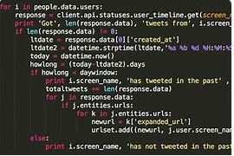
PET 328: Computer Applications in Petroleum Engineering – with Python Programming Dr. Mosobalaje, O. O.
PREAMBLES
Introduction to Computer Programming
A program is simply a collection of sequential Python statements written to perform a specific task

Slide 37
PET 328: Computer Applications in Petroleum Engineering – with Python Programming Dr. Mosobalaje, O. O.
PREAMBLES
Introduction to Computer Programming
Fundamental patterns (concepts) in a program
The following are typical patterns (statement(s)) you see in a program:
Input statements
Output statements
Sequential execution
Conditional statements
Repeated execution (loops)
Reuse of statements (functions)

Slide 38
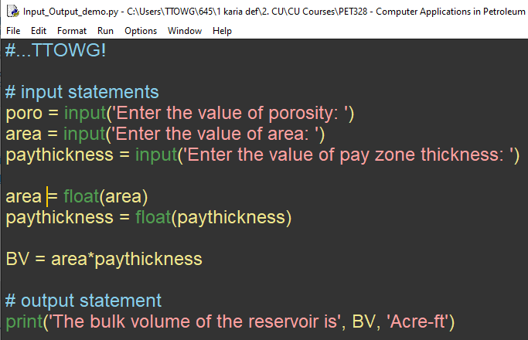
PET 328: Computer Applications in Petroleum Engineering – with Python Programming Dr. Mosobalaje, O. O.
PREAMBLES
Introduction to Computer Programming
Fundamental patterns (concepts) in a program
Input statements: - used to request and accept data from users
Example: the input function.
This script is available here
https://github.com/TTOWG/PET328_2021_Class/blob/main/demo_Input_Output.py

Slide 39
PET 328: Computer Applications in Petroleum Engineering – with Python Programming Dr. Mosobalaje, O. O.
PREAMBLES
Introduction to Computer Programming
Fundamental patterns (concepts) in a program
Output statements: - used to display the results of execution on the screen.
Example: the print function

Slide 40
PET 328: Computer Applications in Petroleum Engineering – with Python Programming Dr. Mosobalaje, O. O.
PREAMBLES
Introduction to Computer Programming
Fundamental patterns (concepts) in a program
Sequential execution: - typically, a program would entail multiple statements.
Statements are executed in the order (sequence) in which they are encountered.
Latter statements can make use of results of former statements; not vice-versa

Slide 41
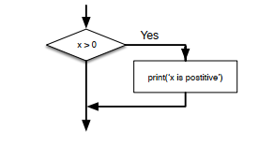
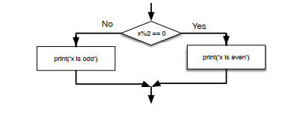
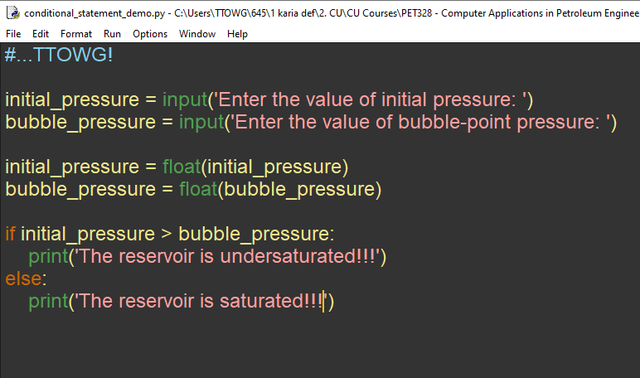
PET 328: Computer Applications in Petroleum Engineering – with Python Programming Dr. Mosobalaje, O. O.
PREAMBLES
Introduction to Computer Programming
Fundamental patterns (concepts) in a program
Conditional Statements: patterns that make it possible for the program to check for some conditions and decide to:
perform a statement(s) or skip the statement(s)
Choose between alternative statements.

Slide 42
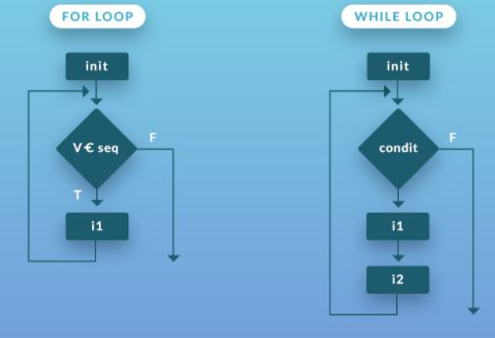
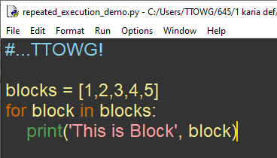
PET 328: Computer Applications in Petroleum Engineering – with Python Programming Dr. Mosobalaje, O. O.
PREAMBLES
Introduction to Computer Programming
Fundamental patterns (concepts) in a program
Repeated Execution: patterns that instructs the program to perform (iterate) a given statement(s) repeatedly, for each item in a set of items, varying values of parameter(s) from item to item.

Slide 43
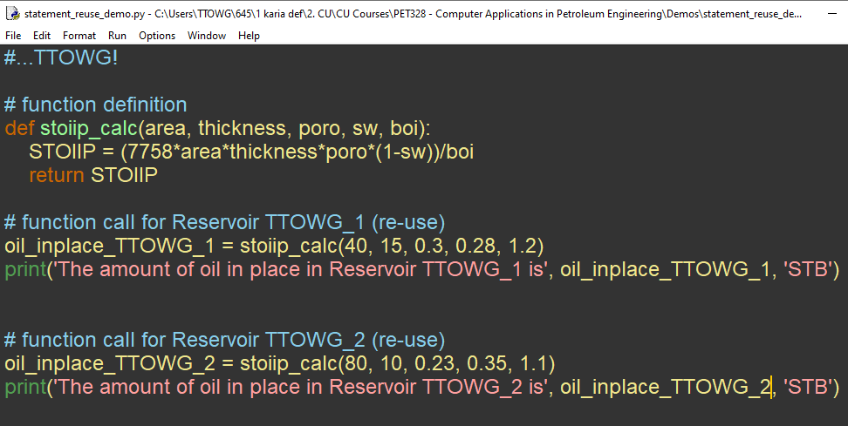
PET 328: Computer Applications in Petroleum Engineering – with Python Programming Dr. Mosobalaje, O. O.
PREAMBLES
Introduction to Computer Programming
Fundamental patterns (concepts) in a program
Re-use of statements: the task performed by some statement(s) might be routine and needed at various points in your program.
Such statement(s) may be written once, saved with a name and re-used at various points in your program by referring to the name.

Slide 44
>>>#TTOWG!
>>>print(‘…to the only wise God’)

Slide 45
PET 328: Computer Applications in Petroleum Engineering – with Python Programming Dr. Mosobalaje, O. O.
GETTING STARTED WITH PYTHON
Coming Soon…
Season 1 Episode 2 –
Getting Started with Python

Slide 46
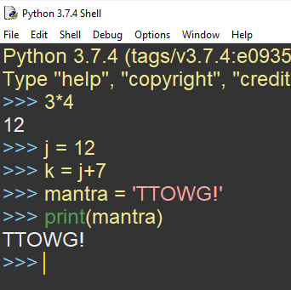
PET 328: Computer Applications in Petroleum Engineering – with Python Programming Dr. Mosobalaje, O. O.
GETTING STARTED WITH PYTHON
Basic Python Objects
Crudely speaking, Python objects are stuffs upon which actions (specified in python commands) are performed.
Example: in the code screenshot shown, 3, 4, j, k, 7, mantra, ‘TTOWG’ are all objects acted upon.

Slide 47
PET 328: Computer Applications in Petroleum Engineering – with Python Programming Dr. Mosobalaje, O. O.
GETTING STARTED WITH PYTHON
Basic Python Objects
The basic Python objects considered here are Values and Variables.
Later, some sets of sophisticated objects known as data structure shall be considered.

Slide 48
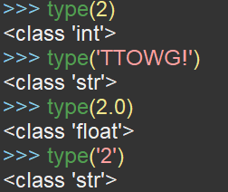
PET 328: Computer Applications in Petroleum Engineering – with Python Programming Dr. Mosobalaje, O. O.
GETTING STARTED WITH PYTHON
Basic Python Objects
Values
Values are simply the representation of data entities.
Types of Values
Values in Python belong to various types such as type integer, type float, and type string.
Use the function type to find out the type to which a value belong.

Slide 49
PET 328: Computer Applications in Petroleum Engineering – with Python Programming Dr. Mosobalaje, O. O.
GETTING STARTED WITH PYTHON
Basic Python Objects
Types of Values
2 is of type (class) integer
‘TTOWG’ and ‘2’ are of type string; just like any set of characters (alphanumeric and non-alphanumeric) enclosed in quotes
2.0 is of type float; just as are all numbers expressed in decimals.

Slide 50
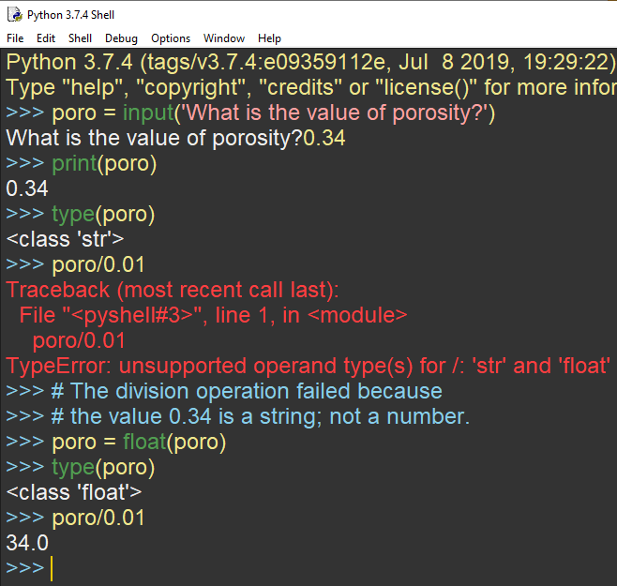
PET 328: Computer Applications in Petroleum Engineering – with Python Programming Dr. Mosobalaje, O. O.
GETTING STARTED WITH PYTHON
Basic Python Objects
Types of Values
Please, take note that users’ response to the input function prompt is stored as a string.
Before using such input in a mathematical operation, they should be converted to a numerical type using float or int functions.

Slide 51
PET 328: Computer Applications in Petroleum Engineering – with Python Programming Dr. Mosobalaje, O. O.
GETTING STARTED WITH PYTHON
Basic Python Objects
Variables
A variable is a value stored in memory and referred to with a chosen name.
In other words, values are assigned to variables.
When the name of a variable is called, the value assigned therein answers.

Slide 52
PET 328: Computer Applications in Petroleum Engineering – with Python Programming Dr. Mosobalaje, O. O.
GETTING STARTED WITH PYTHON
Basic Python Objects
Variables
A raw value can be assigned to a variable.
Example: j is a variable; the value 12 is assigned to it.
Also, the output of an expression (involving a variable) may be stored in another variable.
Example: k is a variable, the value obtained when j+7 is executed is subsequently assigned to variable k.
Not only numeric values are assigned to variables, strings are also assigned.
Example, mantra is a variable with string ‘TTOWG!’ assigned to it.

Slide 53
PET 328: Computer Applications in Petroleum Engineering – with Python Programming Dr. Mosobalaje, O. O.
GETTING STARTED WITH PYTHON
Basic Python Objects
Choosing Variable Names
In naming variable, the following rules are recommended:
Variable names should be descriptive, as much as possible. That is, the name should somewhat tell us something about the variable. Example: a variable to hold the value of reservoir permeability is better named ‘perm’ than named ‘x’
The name must be a single word. Where multiple words are necessary for descriptive purposes, they can be joined with the underscore character; e. g.: init_pressure.
Names should not be too long.
Names may contain both alphabets and numbers; but must not start with numbers.
Names are case sensitive. If you named a variable as ‘poro’, do not refer to it as ‘Poro’.
Avoid using special characters like ‘@’, ‘$’ in names.

Slide 54
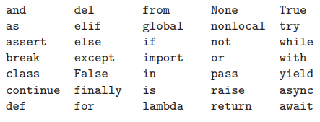
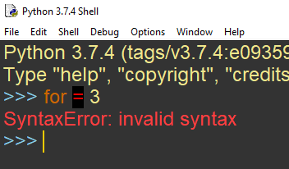
PET 328: Computer Applications in Petroleum Engineering – with Python Programming Dr. Mosobalaje, O. O.
GETTING STARTED WITH PYTHON
Basic Python Objects
Keywords
Keywords are words that are reserved for Python’s in-built structure.
Here is the list of Python’s keywords.
Keywords cannot be used as variable names; doing so would cause error.

Slide 55
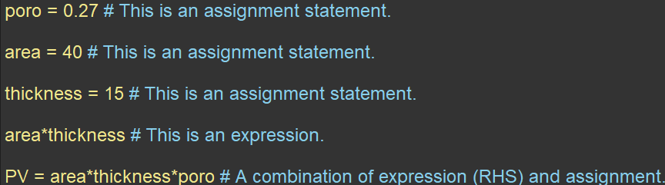
PET 328: Computer Applications in Petroleum Engineering – with Python Programming Dr. Mosobalaje, O. O.
GETTING STARTED WITH PYTHON
Basic Python Objects
Statements
A statement is simply unit of code (commands) that is interpretable and executable by Python; just like a sentence in natural language.
Two common types of Python statements are Assignment statements and Expressions.
Assignment statements simply assigns values to a variable.
An expression is a statement that combines variables, values, functions and operators.
A statement could combine both types such that the result of an expression (RHS) is assigned to a variable (LHS).

Slide 56
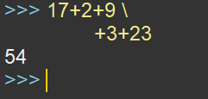
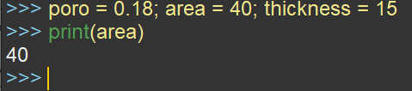
PET 328: Computer Applications in Petroleum Engineering – with Python Programming Dr. Mosobalaje, O. O.
GETTING STARTED WITH PYTHON
Basic Python Objects
Multi-line statements
Typically, a Python statement is written in a single line.
However, if the statement is too long, it could be continued in the next line; but the current line should end with the line continuation character i.e. \
Multiple statements in a line
Writing multiple statements in same line is not encouraged; however, if that has to be done, the statements should be separated by semicolon.

Slide 57
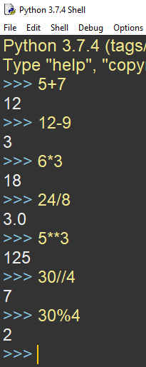
PET 328: Computer Applications in Petroleum Engineering – with Python Programming Dr. Mosobalaje, O. O.
GETTING STARTED WITH PYTHON
Basic Python Objects
Operators
Operators are symbols of mathematical operations.
+ for addition
- for subtraction
* for multiplication
/ for division
** for exponentiation (raise to power)
// integer division (truncates the result of division to its integer part.
% modulus (gives the remainder of an integer division).
The objects acted upon by operators are called operands.

Slide 58
PET 328: Computer Applications in Petroleum Engineering – with Python Programming Dr. Mosobalaje, O. O.
GETTING STARTED WITH PYTHON
Basic Python Objects
Order of Operations
When multiple operations are featured in a statement, Python executes them in the order specified by the accronym: PE-MD-AS (Parenthesis, Exponentiation, Multiplication, Division, and Subtraction).
You can used parenthesis to dictate the order you desire.
Multiplication and Division has equal precedence; hence are executed left to right.
Addittion and Subtraction has equal precedence; hence are executed left to right.
You may also use parenthesis to make an expression more readable and less confusing.
Nested parenthesis are executed from inside to outside.

Slide 59
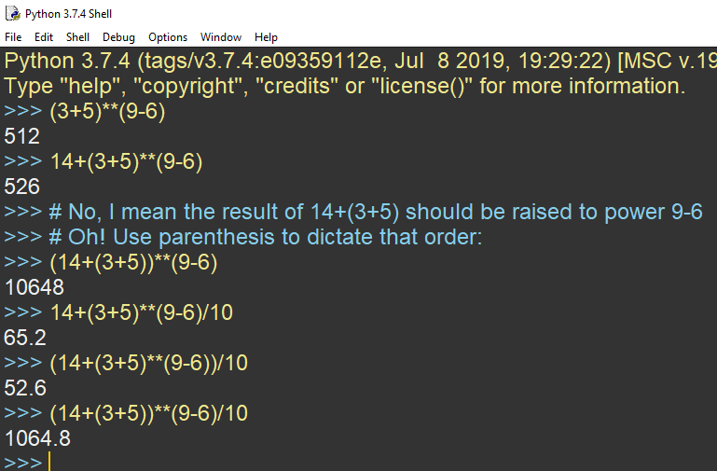
PET 328: Computer Applications in Petroleum Engineering – with Python Programming Dr. Mosobalaje, O. O.
GETTING STARTED WITH PYTHON
Basic Python Objects
Order of Operations
Consider the following operations to convince yourself of the PEMDAS order.

Slide 60
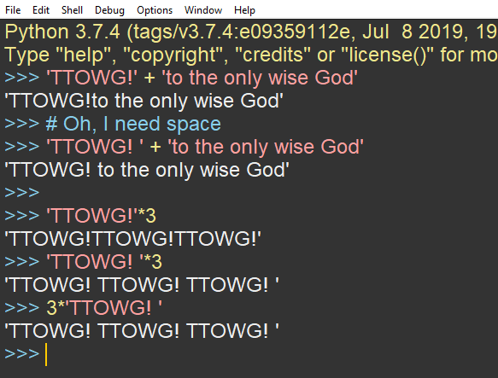
PET 328: Computer Applications in Petroleum Engineering – with Python Programming Dr. Mosobalaje, O. O.
GETTING STARTED WITH PYTHON
Basic Python Objects
String Operations
Strings can be joined end-to-end by using the + operator. If you want a space between the strings, then include it in one of the strings.
Also, a string can be repeated multiple times using the * operator (with and integer, of course).

Slide 61
PET 328: Computer Applications in Petroleum Engineering – with Python Programming Dr. Mosobalaje, O. O.
GETTING STARTED WITH PYTHON
Conditional Statements
Conditional statements are written to make it possible for a program to check for some conditions and decide to:
perform a statement(s) or skip the statement(s)
Choose between alternative statements.
So, the concept of condition is central to this kind of statements.
These conditions are crafted using the concept of Boolean expressions.

Slide 62
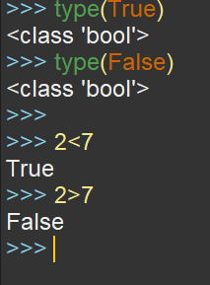
PET 328: Computer Applications in Petroleum Engineering – with Python Programming Dr. Mosobalaje, O. O.
GETTING STARTED WITH PYTHON
Conditional Statements
Boolean Expressions
A boolean is a value that is either True or False
Just like the integer type can take values 1, 2, 3 e.t.c; the boolean type can take one of just two values: True or False.
For this reason, ‘True’ and ‘False’ are Python keywords reserved for boolean values; a variable must not be named using these words.
Now, a boolean expression is essentially a comparison expression that evaluates to either True or False.

Slide 63
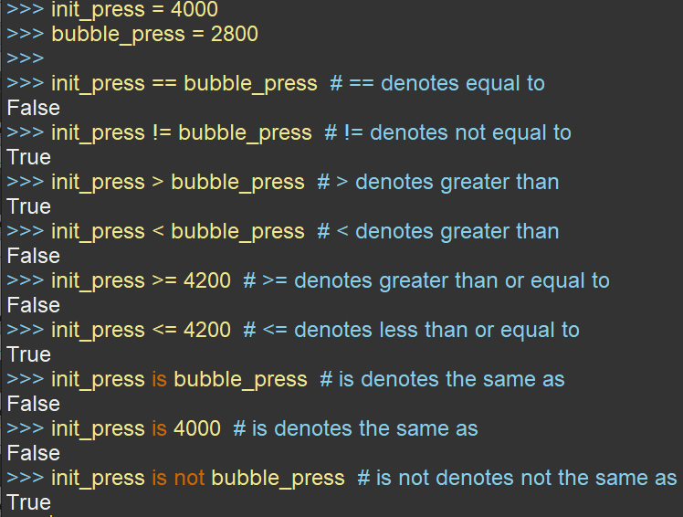
PET 328: Computer Applications in Petroleum Engineering – with Python Programming Dr. Mosobalaje, O. O.
GETTING STARTED WITH PYTHON
Conditional Statements
Boolean Expressions
Boolean expressions are constructed using comparison operators listed here.
Take note that = is an assignment operator while == is a comparison operator.

Slide 64
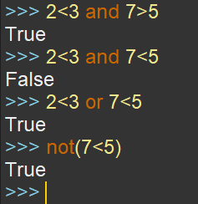
PET 328: Computer Applications in Petroleum Engineering – with Python Programming Dr. Mosobalaje, O. O.
GETTING STARTED WITH PYTHON
Conditional Statements
Logical Operators
Sometimes, multiple conditions needed to be checked in a conditional statement.
Logical operators are used to combine boolean expressions
and returns True if all conditions are true, true, otherwise, False is returned.
or returns True if one of the conditions is true, otherwise, False is returned.
Logical operators are also used to negate boolean expressions
not returns True for a false condition and vice-versa

Slide 65
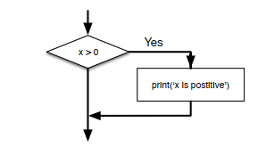
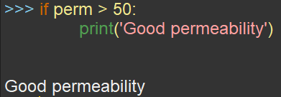
PET 328: Computer Applications in Petroleum Engineering – with Python Programming Dr. Mosobalaje, O. O.
GETTING STARTED WITH PYTHON
Conditional Statements
if… Statement (Conditional Execution)
if statements evaluates the given condition; performs the given statement(s) if condition is true and skips the given statement(s) if condition is false.
The condition(s) is written after the if keyword and ended with a colon i.e. (:)
The statements to be performed or skip are written as an indented block in subsequent line(s).
Remove the indentation in lines after the if block.

Slide 66
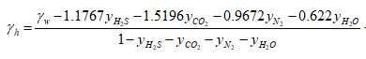
PET 328: Computer Applications in Petroleum Engineering – with Python Programming Dr. Mosobalaje, O. O.
GETTING STARTED WITH PYTHON
Conditional Statements
if… Statement (Conditional Execution)
Petroleum engineering application
Computing pseudo-critical gas properties using Sutton’s correlation
Sutton developed a correlation for estimating for estimating P_{pc} and T_{pc} as functions of gas gravity.
Here is the first step in Sutton’s procedure:
If the gas mixture contains <12 mol% of CO₂, < 3% of Nitrogen and no H₂S, then the parameter γ_{h} takes the same value as the given separator gas gravity (γ_{g}) or the given well-stream gravity (γ_{w})
However, if gas mixture contains >12 mol% of CO₂, >3% of Nitrogen and any H₂S, then the parameter γ_{h} is determined thus:

Slide 67
PET 328: Computer Applications in Petroleum Engineering – with Python Programming Dr. Mosobalaje, O. O.
GETTING STARTED WITH PYTHON
Conditional Statements
if… Statement (Conditional Execution)
Petroleum engineering application
Computing pseudo-critical gas properties using Sutton’s correlation
The first step in Sutton’s can be executed with an if … statement.
Observe that the procedure implies that if any of the impurities in the gas exceeds the stated threshold value, then, the given gas gravity (γ_{w}) need to be corrected for the effects of the impurities, using the given equation.
However, the correction task should be neglected if none of the impurities exceeds its threshold value.

Slide 68
PET 328: Computer Applications in Petroleum Engineering – with Python Programming Dr. Mosobalaje, O. O.
GETTING STARTED WITH PYTHON
Conditional Statements
if… Statement (Conditional Execution)
Petroleum engineering application
Computing pseudo-critical gas properties using Sutton’s correlation
To execute this procedure, we simply construct a Boolean condition to test if any threshold is violated.
If the condition is evaluated as True, then a block of statement to perform the gs gravity correction is executed.
If the condition is evaluated to be False, there is no need for the correction, hence, the block of statement is skipped.

Slide 69
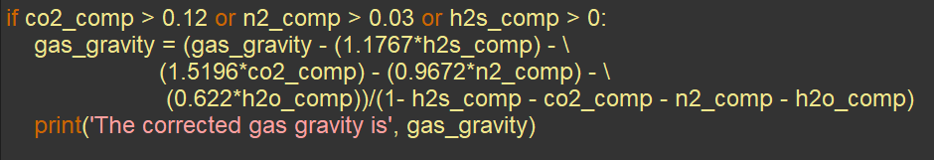
PET 328: Computer Applications in Petroleum Engineering – with Python Programming Dr. Mosobalaje, O. O.
GETTING STARTED WITH PYTHON
Conditional Statements
if… Statement (Conditional Execution)
Petroleum engineering application
Computing pseudo-critical gas properties using Sutton’s correlation
The full script for this computation is available here

Slide 70
PET 328: Computer Applications in Petroleum Engineering – with Python Programming Dr. Mosobalaje, O. O.
GETTING STARTED WITH PYTHON
Conditional Statements
if… Statement (Conditional Execution)
Assignment 2
Upgrade the demo_gas_grav_corr.py script (hosted on TTOWG/ PET328_2021_Class GitHub repository) to perform the entire Sutton’s procedure. Save the upgraded script as sutton_correlation.py, commit and push it to your GitHub repository. Submit the URL to your copy of PET328_2021_Class repository. Furthermore, send a pull request to the original TTOWG/ PET328_2021_Class repository.
The complete Sutton’s algorithm is available here.

Slide 71
PET 328: Computer Applications in Petroleum Engineering – with Python Programming Dr. Mosobalaje, O. O.
GETTING STARTED WITH PYTHON
Conditional Statements
if… Statement (Conditional Execution)
Assignment 2
You may test run your script with the following data:
Inputs
y_{CO2} = 0.0164
y_{N2} = 0.0236
y_{H2S} = 0.1841
Gas gravity = 0.6992
Outputs
Corrected gas gravity = 0.5604
Ppch = 682.3 psia.
Tpch = 341.8 deg Rankine
Ppc = 799.0 psia.
Tpc = 403.3 deg Rankine

Slide 72
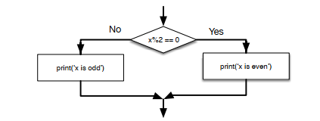
PET 328: Computer Applications in Petroleum Engineering – with Python Programming Dr. Mosobalaje, O. O.
GETTING STARTED WITH PYTHON
Conditional Statements
if…then…else Statement (Alternative Execution)
The if…then…else structure is deployed when there are two alternative tasks and a condition that determines which of the two alternatives should be executed.
Essentially, there will be a Boolean condition, and two blocks (branches) of statements.
The first branch (after the condition) is to be executed if the condition evaluates to True while the second branch (after the keyword ‘else’) is executed if the condition evaluates to False.

Slide 73
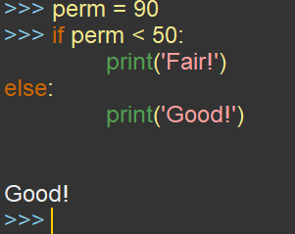
PET 328: Computer Applications in Petroleum Engineering – with Python Programming Dr. Mosobalaje, O. O.
GETTING STARTED WITH PYTHON
Conditional Statements
if…then…else Statement (Alternative Execution)
The condition(s) is written after the if keyword and ended with a colon i.e. (:)
Then, the statement(s) to be performed if condition is True (i.e., Branch True) are written as an indented block in subsequent line(s).
Thereafter, the keyword ‘else’ is written on the next line just after the Branch True. The ‘else’ keyword should be indented to the same level as the ‘if’ keyword.
Finally, the statement(s) to be performed if condition is False (i.e., Branch False) are written as an indented block in subsequent line(s).

Slide 74
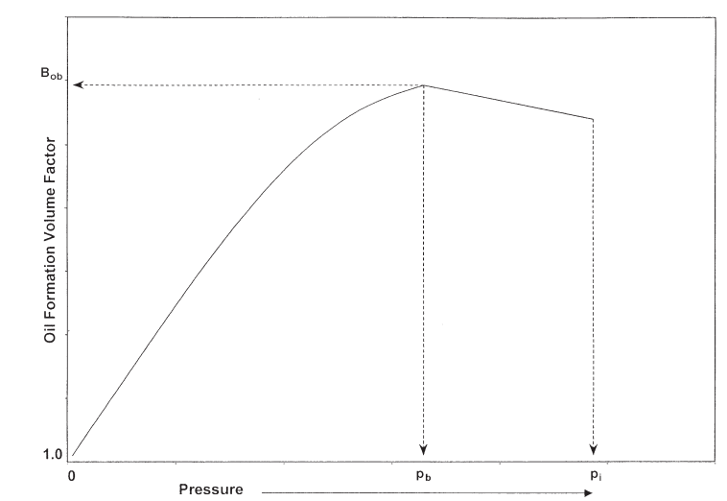
PET 328: Computer Applications in Petroleum Engineering – with Python Programming Dr. Mosobalaje, O. O.
GETTING STARTED WITH PYTHON
Conditional Statements
if…then…else Statement (Alternative Execution)
Petroleum engineering application
Computing oil formation volume factor, Bo.
The variation of oil formation volume factor, Bo, with pressure is divided into two pressure regimes, as shown.

Slide 75
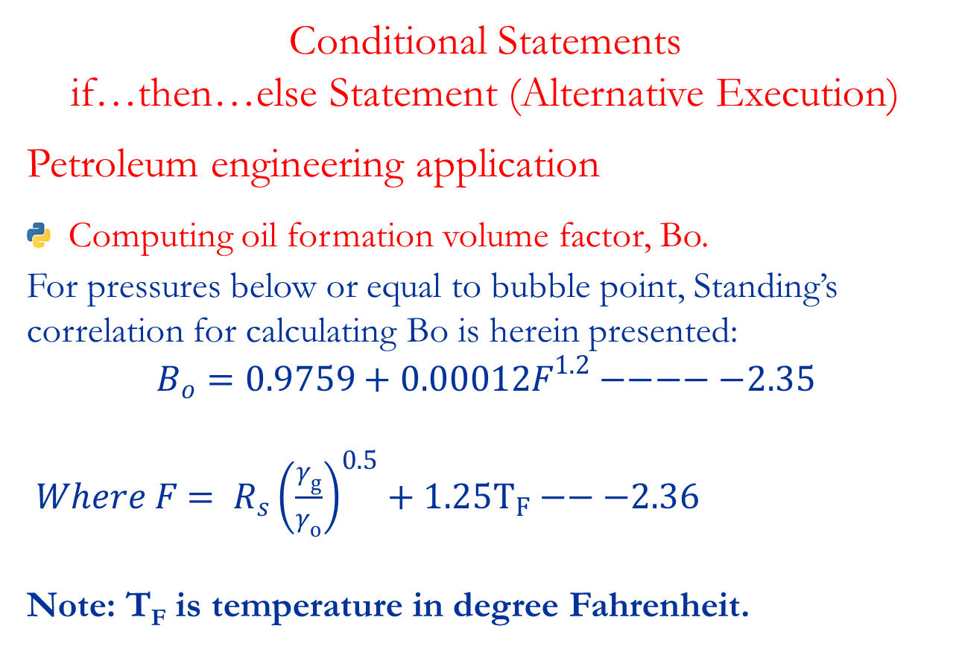
PET 328: Computer Applications in Petroleum Engineering – with Python Programming Dr. Mosobalaje, O. O.
GETTING STARTED WITH PYTHON
Conditional Statements
if…then…else Statement (Alternative Execution)
Petroleum engineering application
Computing oil formation volume factor, Bo.
For pressures below or equal to bubble point, Standing’s correlation for calculating Bo is herein presented:
$$B_{o}=0.9759+0.00012F^{1.2}−−−−−2.35$$
$Where F= R_{s}{\left(\frac{γ_{g}}{γ_{o}}\right)}^{0.5}+1.25T_{F}−−−2.36$
Note: T_{F} is temperature in degree Fahrenheit.

Slide 76
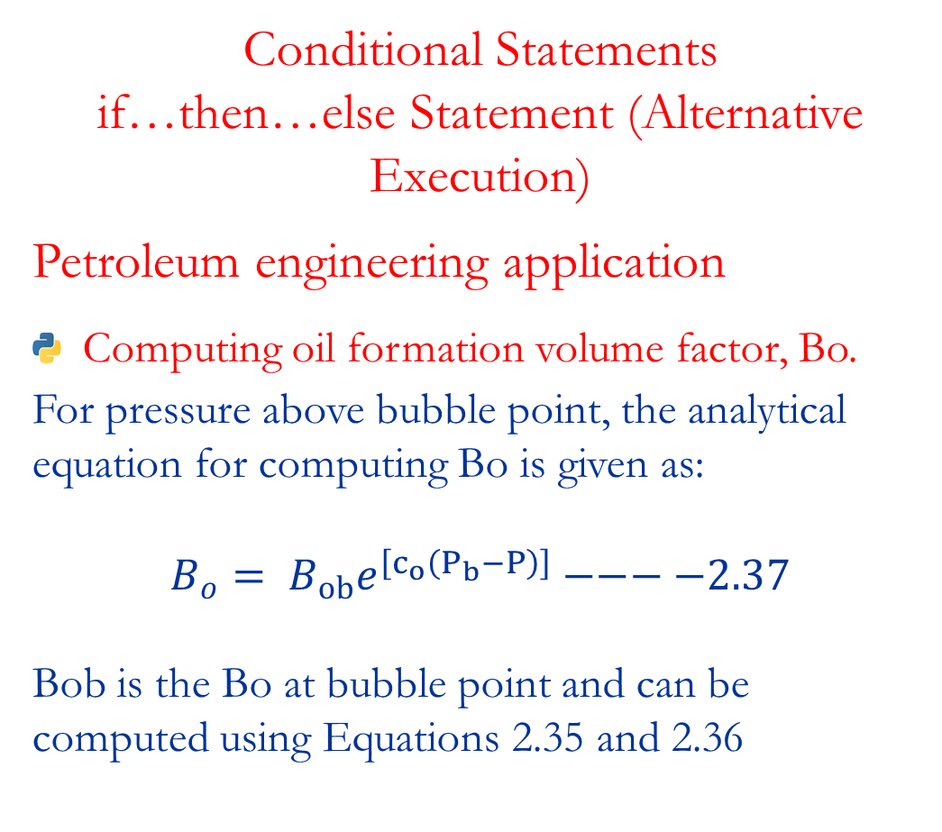
PET 328: Computer Applications in Petroleum Engineering – with Python Programming Dr. Mosobalaje, O. O.
GETTING STARTED WITH PYTHON
Conditional Statements
if…then…else Statement (Alternative Execution)
Petroleum engineering application
Computing oil formation volume factor, Bo.
For pressure above bubble point, the analytical equation for computing Bo is given as:
$$B_{o}= B_{ob}e^{\left[c_{o}\left(P_{b}−P\right)\right]}−−−−2.37$$
Bob is the Bo at bubble point and can be computed using Equations 2.35 and 2.36

Slide 77
PET 328: Computer Applications in Petroleum Engineering – with Python Programming Dr. Mosobalaje, O. O.
GETTING STARTED WITH PYTHON
Conditional Statements
if…then…else Statement (Alternative Execution)
Petroleum engineering application
Computing oil formation volume factor, Bo.
To execute this procedure, we simply construct a Boolean condition to test if the current reservoir pressure, p, is greater than the bubble-point pressure of the reservoir.
If the condition is evaluated as True, then a block of statement to implement Equation 2.37 is executed.
Else, if the condition is evaluated to be False, then a block of statement to implement Equation 2.35 is executed.
Note that Equation 2.36 need to be implemented for either of the alternatives, hence, the line to execute it is written before the if…then…else statement.

Slide 78
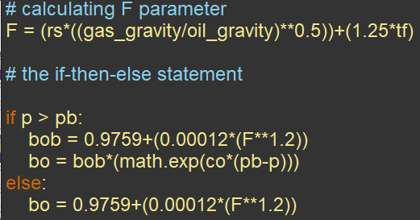
PET 328: Computer Applications in Petroleum Engineering – with Python Programming Dr. Mosobalaje, O. O.
GETTING STARTED WITH PYTHON
Conditional Statements
if…then…else Statement (Alternative Execution)
Petroleum engineering application
Computing oil formation volume factor, Bo.
The full script for this computation is available here.

Slide 79
PET 328: Computer Applications in Petroleum Engineering – with Python Programming Dr. Mosobalaje, O. O.
GETTING STARTED WITH PYTHON
Conditional Statements
Reading Assignment
Read on Chained Conditionals (if…elif… statements) and Nested Conditionals, in the recommended textbook for this course (pages 34 – 36)
Recommended Textbook: Python for Everybody: Exploring Data using Python 3, by Charles Severance.

Slide 80
PET 328: Computer Applications in Petroleum Engineering – with Python Programming Dr. Mosobalaje, O. O.
GETTING STARTED WITH PYTHON
Repeated Execution
One major reason for writing computer programs is to automate repetitive workflows.
When a given task is to be performed repeatedly for each member of a set of entities, that is a repetitive workflow.
In implementing such workflows, moving from one entity to the next entity is called looping or iterating.

Slide 81
PET 328: Computer Applications in Petroleum Engineering – with Python Programming Dr. Mosobalaje, O. O.
GETTING STARTED WITH PYTHON
Repeated Execution
Sometimes, the list of entities in the set is known explicitly and presented to the computer – that is a definite loop.
At other times, the list is not known explicitly, rather the computer is asked to perform the task repeatedly until a given condition becomes False – that is an indefinite loop.
Definite loops are implemented with ‘for’ loops and indefinite loops are implemented with ‘while’ loops.

Slide 82
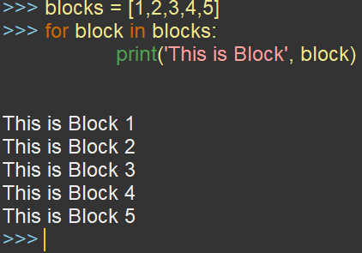
PET 328: Computer Applications in Petroleum Engineering – with Python Programming Dr. Mosobalaje, O. O.
GETTING STARTED WITH PYTHON
Repeated Execution
for… loops
In practice, ‘for’ loops are used in counting the number of items/elements in a list or in summing up (aggregating) the results of a computation for every item/element in a list.
In such cases, a variable to hold the count or sum is normally, created and set to a dummy initial value before the ‘for’ loop.
The first line (header) of a ‘for’ loop begins with the keyword ‘for’, followed by an iterator variable, followed by the keyword ‘in’ and lastly, the list of items on which the task is to be performed.
Statement(s) to implement the task are written as an indented block on subsequent lines after the header.

Slide 83


PET 328: Computer Applications in Petroleum Engineering – with Python Programming Dr. Mosobalaje, O. O.
GETTING STARTED WITH PYTHON
Repeated Execution
for… loops
Iterator variable
The iterator variable is a sort of temporary variable that represent the item/element of the set being treated in the current loop cycle.
So, the iterator variable changes value as the program loops through the list of items.
Sometimes, the in-built function range is used to generate the list of items.

Slide 84
PET 328: Computer Applications in Petroleum Engineering – with Python Programming Dr. Mosobalaje, O. O.
GETTING STARTED WITH PYTHON
Repeated Execution
for… loops
Petroleum engineering application
Reservoir discretization
Input parameters required to solve reservoir engineering models are essentially rock and fluid properties.
These rock and fluid properties are known to vary across the reservoir – heterogeneity.
The challenge: which value of a property is to be used in solving the model for a given reservoir???
Average??? Nay!
Locally-acceptable values??? Yes!

Slide 85

PET 328: Computer Applications in Petroleum Engineering – with Python Programming Dr. Mosobalaje, O. O.
GETTING STARTED WITH PYTHON
Repeated Execution
for… loops
Petroleum engineering application
Reservoir discretization
Discretization is the means by which locally-acceptable values of reservoir rock and fluid properties are honored in reservoir modelling.
Loosely speaking, reservoir discretization is the division of the reservoirs into grid-blocks whose properties, dimensions and locations are well defined and uniform.
Upon discretizing the reservoir into blocks; the flow model would then need be written and solved, repeatedly, for each block.

Slide 86
PET 328: Computer Applications in Petroleum Engineering – with Python Programming Dr. Mosobalaje, O. O.
GETTING STARTED WITH PYTHON
Repeated Execution
for… loops
Petroleum engineering application
Reservoir discretization
Blocks Ordering (Numbering) Schemes –
a way to identify each block in 1D, 2D or 3D discretized model.
Two types of ordering:
Engineering ordering.
Natural ordering

Slide 87



PET 328: Computer Applications in Petroleum Engineering – with Python Programming Dr. Mosobalaje, O. O.
GETTING STARTED WITH PYTHON
Repeated Execution
for… loops
Petroleum engineering application
Reservoir discretization
Engineering Ordering –
uses i, j, k, notations to order blocks in the x, y, z directions respectively.
i – counts columns along a certain row;
j – counts rows along a certain column;
k refers to layers.

Slide 88


PET 328: Computer Applications in Petroleum Engineering – with Python Programming Dr. Mosobalaje, O. O.
GETTING STARTED WITH PYTHON
Repeated Execution
for… loops
Petroleum engineering application
Reservoir discretization
Natural Ordering –
uses natural counting scheme.
Columns are counted fastest, followed by rows and then layers.

Slide 89
PET 328: Computer Applications in Petroleum Engineering – with Python Programming Dr. Mosobalaje, O. O.
GETTING STARTED WITH PYTHON
Repeated Execution
for… loops
Petroleum engineering application
Reservoir discretization
The engineering ordering fits perfectly well into the ‘for’ loop scheme.
Looping through columns in a given row would be implemented by a column ‘for’ loop whose iterator variable would be i (the column counter).
Looping through rows in a given layer would be implemented by a row ‘for’ loop whose iterator variable would be j (the row counter).
Looping through layers would be implemented by a layer ‘for’ loop whose iterator variable would be k (the layer counter).

Slide 90
PET 328: Computer Applications in Petroleum Engineering – with Python Programming Dr. Mosobalaje, O. O.
GETTING STARTED WITH PYTHON
Repeated Execution
for… loops
Petroleum engineering application
Reservoir discretization
In a one-dimensional discretized model (i.e. a model discretized in only one direction), only one ‘for’ loop is needed; it may be column, row or layer loop.
In a multi-dimensional discretized model (i.e. a model discretized in multiple directions), multiple nested ‘for’ loops are needed; with the column loop cycling faster than the row loop and the row loop cycling faster than the layer loop.
In nested loop, the innermost loop cycles fastest while the outermost loop cycles the slowest.

Slide 91

PET 328: Computer Applications in Petroleum Engineering – with Python Programming Dr. Mosobalaje, O. O.
GETTING STARTED WITH PYTHON
Repeated Execution
for… loops
Petroleum engineering application
Reservoir discretization
While the engineering ordering is used in computations, communicating outputs of such computations is better done with natural ordering.
The following equation can be used to obtain the natural ordering index of a block from its engineering ordering indices (i, j, k)
$$n_{order}= \left[\left(k−1\right)n_{x}.n_{y}\right]+\left[\left(j−1\right)n_{x}\right]+i$$
n_{order} = natural order index of the block
i is the column index of the block
j is the row index of the block
k is the layer index of the block
n_{x} is the number of blocks in x-direction (i.e. number of columns)
n_{y} is the number of blocks in y-direction
A constant value of 1 is used for any of the i, j, k indices not relevant to a case at hand.

Slide 92

PET 328: Computer Applications in Petroleum Engineering – with Python Programming Dr. Mosobalaje, O. O.
GETTING STARTED WITH PYTHON
Repeated Execution
for… loops
Petroleum engineering application
Computing STOIIP for a discretized reservoir model
The amount of stock tank oil in-place in a given reservoir is given thus:
$$STOIIP=\frac{7758Ahφ(1−S_{wi})}{B_{oi}}$$
Typically, values of porosity (ϕ)and initial water saturation varies across the reservoir; hence, the given reservoir is discretized and the STOIIP equation is implemented for each block of the discretized model. The STOIIP for each is block aggregated in a running total to yield the reservoir STOIIP ultimately.

Slide 93

PET 328: Computer Applications in Petroleum Engineering – with Python Programming Dr. Mosobalaje, O. O.
GETTING STARTED WITH PYTHON
Repeated Execution
for… loops
Petroleum engineering application
Computing STOIIP for a discretized reservoir model
Here is a simple (trivial) 2D example of the grid of such discretized reservoir models.

Slide 94

PET 328: Computer Applications in Petroleum Engineering – with Python Programming Dr. Mosobalaje, O. O.
GETTING STARTED WITH PYTHON
Repeated Execution
for… loops
Petroleum engineering application
Computing STOIIP for a discretized reservoir model
The full script for this computation is available here.
Disclaimer: the implementation of this task as presented in the script is only for pedagogical purposes; in reality, a more efficient implementation would be done.

Slide 95

PET 328: Computer Applications in Petroleum Engineering – with Python Programming Dr. Mosobalaje, O. O.
GETTING STARTED WITH PYTHON
Repeated Execution
for… loops
Assignment 3
An undersaturated oil reservoir material balance simulator computes the cumulative oil produced from a block, in a discretized model, thus:
$$N_{p}=\frac{NB_{oi}c_{e}\left(P_{i}−P_{now}\right)}{B_{o}}−−−−−−−−P5$$
N_{p} is the cumulative oil produced from a given block.
N is the initial oil in-place (STOIIP) for each block (assumed constant for all blocks)
B_{oi} is the initial oil formation volume factor (assumed constant for all blocks)
c_{e} is the effective compressibility (assumed constant for all blocks)
P_{i} is the initial reservoir pressure (assumed constant for all blocks)
P_{now} is the current reservoir pressure (varies across blocks depending on proximity to producer well)
B_{o} is the current value of the oil formation volume factor (depends on current pressure in a block)

Slide 96

PET 328: Computer Applications in Petroleum Engineering – with Python Programming Dr. Mosobalaje, O. O.
GETTING STARTED WITH PYTHON
Repeated Execution
for… loops
Assignment 3
Below is the expression to calculate the $B_{o}$ value corresponding to a given current pressure.
$$B_{o}=B_{ob}\left[1−c_{o}\left(P_{now}−P_{b}\right)\right]−−−−−−−−−−P6$$
Given a set of parameter (N_{p}, B_{oi}, B_{ob}, c_{e}, c_{o} and P_{i}) values and a grid of current pressure values, write a Python script to implement Equations P5 and P6 for each block. Also include statements to sum up and present the total cumulative oil produced from the entire reservoir.
Save the script as mat_bal.py, commit and push it to your GitHub repository. Submit the URL to your copy of PET328_2021_Class repository. Furthermore, send a pull request to the original TTOWG/ PET328_2021_Class repository.

Slide 97

PET 328: Computer Applications in Petroleum Engineering – with Python Programming Dr. Mosobalaje, O. O.
GETTING STARTED WITH PYTHON
Repeated Execution
for… loops
Assignment 3
You may test your script with the following data:
Parameters
N = 200,779.157 STB
P_{i} = 4025 psi
P_{b} = 3330 psi
B_{oi} = 1.2417 RB/STB
B_{ob} = 1.2511RB/STB
c_{e} = co = 0.0000113 psi⁻¹

Slide 98

PET 328: Computer Applications in Petroleum Engineering – with Python Programming Dr. Mosobalaje, O. O.
GETTING STARTED WITH PYTHON
Repeated Execution
while... loops
Indefinite loops are implemented with ‘while’ loops.
Unlike ‘for’ loops, a definite list of items to be acted upon is not presented to ‘while’ loops.
Rather, ‘while’ loops performs a given block of statement(s) until a specified condition is evaluated to be False; then it stops.
The loop runs if the specified condition is True, just like an ‘if’ statement.
However, unlike an ‘if’ statement, the ‘while’ loop repeats the block of statement(s).

Slide 99
PET 328: Computer Applications in Petroleum Engineering – with Python Programming Dr. Mosobalaje, O. O.
GETTING STARTED WITH PYTHON
Repeated Execution
while... loops
The execution of ‘while’ loops goes thus:
Evaluate the specified condition
If condition is False, exit the loop and continue with statements(s) outside (below) the loop.
Execute the block of statement(s) if condition is true and return to evaluation step

Slide 100
PET 328: Computer Applications in Petroleum Engineering – with Python Programming Dr. Mosobalaje, O. O.
GETTING STARTED WITH PYTHON
Repeated Execution
while... loops
The ‘while’ loop condition is constructed as Boolean expression.
Typically, the condition involves an iterator variable that is normally initialized outside (before) the loop and gets updated in the loop (during each iteration).
It is by such changes (updates) to the value of the iterator variable that the condition would eventually turn False and the loop gets terminated.

Slide 101
PET 328: Computer Applications in Petroleum Engineering – with Python Programming Dr. Mosobalaje, O. O.
GETTING STARTED WITH PYTHON
Repeated Execution
while... loops
When the iteration variable is not specified or not updated, the loop runs forever – infinite loops.
Reading Assignment:
Read on Infinite Loops, ‘break’ and ‘continue’ statements in the textbook recommended for this course.

Slide 102
PET 328: Computer Applications in Petroleum Engineering – with Python Programming Dr. Mosobalaje, O. O.
GETTING STARTED WITH PYTHON
Repeated Execution
while... Loops
Petroleum engineering applications
The ‘while’ loops finds applications in cases where a task need to be performed for a series of dynamically-changing values of a variable (like pressure) until that variable violates a specified threshold value.
For instance, in scripting an undersaturated oil reservoir simulator, computations are to be performed for series of decreasing pressure values until pressure reduces to a value below bubble-point pressure.

Slide 103

PET 328: Computer Applications in Petroleum Engineering – with Python Programming Dr. Mosobalaje, O. O.
GETTING STARTED WITH PYTHON
Repeated Execution
while... Loops
Petroleum engineering applications
See a trivial example here.

Slide 104

PET 328: Computer Applications in Petroleum Engineering – with Python Programming Dr. Mosobalaje, O. O.
GETTING STARTED WITH PYTHON
Repeated Execution
while... Loops
Petroleum engineering applications
Updating oil formation volume factor (Bo), for undersaturated reservoir simulation.
Recall that, the analytical equation for computing Bo, at pressures above bubble point is given as: (see Slide 75 – 76)
$$B_{o}= B_{ob}e^{\left[c_{o}\left(P_{b}−P\right)\right]}−−−−2.37$$
There is a need to write statement that would not just compute Bo at a single pressure value, but at series of decreasing pressure values until pressure decreases to bubble point pressure, at which point, the simulation must be terminated.

Slide 105

PET 328: Computer Applications in Petroleum Engineering – with Python Programming Dr. Mosobalaje, O. O.
GETTING STARTED WITH PYTHON
Repeated Execution
while... Loops
Petroleum engineering applications
Updating oil formation volume factor (Bo), for undersaturated reservoir simulation.
The full script for this computation is available here.

Slide 106

PET 328: Computer Applications in Petroleum Engineering – with Python Programming Dr. Mosobalaje, O. O.
GETTING STARTED WITH PYTHON
Repeated Execution
while... Loops
Petroleum engineering applications
Updating oil formation volume factor (Bo), for undersaturated reservoir simulation.

Slide 107
PET 328: Computer Applications in Petroleum Engineering – with Python Programming Dr. Mosobalaje, O. O.
GETTING STARTED WITH PYTHON
Functions (Reusable Code)
Sometimes, you write a code (sequence of statements) to perform a task, and you realize you often perform that task; may be in the same program, or in other programs.
You don’t want to keep writing (or copying) same code anytime you need to perform such task.
You may give the code (sequence of statements) a cute name; so that anytime that task is to be performed, you simply call that name and the entire sequence of statements in the code get executed!
Such named sequence of code is known as functions.

Slide 108
PET 328: Computer Applications in Petroleum Engineering – with Python Programming Dr. Mosobalaje, O. O.
GETTING STARTED WITH PYTHON
Functions (Reusable Code)
Benefits of writing functions:
Saves typing efforts
Reduces the risk of mistakes
Help to organize your codes
Makes your code more readable
Take note, functions (named sequence of statements) are objects just as variables (named values) are objects.
The installed (base)Python itself thrives on a lot of in-built functions such as print, input, range, min, max, len, float, int, str etc.
Functions created (defined) by users (i.e. not built into Python during installation) are known as user-defined functions.

Slide 109

PET 328: Computer Applications in Petroleum Engineering – with Python Programming Dr. Mosobalaje, O. O.
GETTING STARTED WITH PYTHON
Functions (Reusable Code)
Function Definition:
The first line (header) of a function definition starts with the keyword def, followed by the name of the function (as chosen by you), followed by a comma-separated list of function argument(s) enclosed in parenthesis, and finally, a colon.
If the function requires no arguments, an empty parenthesis () is typed.

Slide 110
PET 328: Computer Applications in Petroleum Engineering – with Python Programming Dr. Mosobalaje, O. O.
GETTING STARTED WITH PYTHON
Functions (Reusable Code)
Function Definition:
The sequence of statements (to be executed whenever the function is called) is known as the body of the function, and is written in subsequent indented lines after the function’s header.
A statement specifying the value(s) to be returned by the function must be included with the keyword return

Slide 111
PET 328: Computer Applications in Petroleum Engineering – with Python Programming Dr. Mosobalaje, O. O.
GETTING STARTED WITH PYTHON
Functions (Reusable Code)
Function Arguments:
The arguments of a function are the values that that it would need to execute its sequence of statements when called.
When defining a function, placeholders (variables) corresponding to these arguments are named and listed.
When the function is called, actual values for the arguments are specified (more on this, soon).

Slide 112
PET 328: Computer Applications in Petroleum Engineering – with Python Programming Dr. Mosobalaje, O. O.
GETTING STARTED WITH PYTHON
Functions (Reusable Code)
Function Arguments:
Default arguments
In some cases, some arguments may have default values – a standard value to take if value is not provided in the function call.
Such default value is to be assigned to the concerned argument name at the point of defining the function.
All such default arguments should only be listed after all un-defaulted arguments have been listed.

Slide 113

PET 328: Computer Applications in Petroleum Engineering – with Python Programming Dr. Mosobalaje, O. O.
GETTING STARTED WITH PYTHON
Functions (Reusable Code)
Function Arguments:
Default arguments
Example: the density of a real gas (in lb/ft³) is computed thus:
$ρ_{g}=\frac{2.7Pγ_{g}}{zT}$
While the equation above works for gas density at any given values of pressure and temperature; often, engineers want to compute gas density specifically at standard values of pressure (14.7 psia) and temperature (520⁰R). At these values, z takes a standard value of 1.0.

Slide 114

PET 328: Computer Applications in Petroleum Engineering – with Python Programming Dr. Mosobalaje, O. O.
GETTING STARTED WITH PYTHON
Functions (Reusable Code)
Function Arguments:
Default arguments
In this example, the function might be defined to accommodate these default values.
However, the user may still specify other values for these default arguments when calling the function (more on this, soon).

Slide 115

PET 328: Computer Applications in Petroleum Engineering – with Python Programming Dr. Mosobalaje, O. O.
GETTING STARTED WITH PYTHON
Functions (Reusable Code)
Return value:
A function should have a return statement specifying an output to be returned when called.
The value to be returned is typically an output generated by one of the statements in the function; not necessarily the last output in the sequence.
A collection of more than one value may be returned.

Slide 116


PET 328: Computer Applications in Petroleum Engineering – with Python Programming Dr. Mosobalaje, O. O.
GETTING STARTED WITH PYTHON
Functions (Reusable Code)
Return value:
Alternative return values may exist, if the task involved a conditional execution.
When no return value is specified, the function simply return a special value called None.

Slide 117


PET 328: Computer Applications in Petroleum Engineering – with Python Programming Dr. Mosobalaje, O. O.
GETTING STARTED WITH PYTHON
Functions (Reusable Code)
Calling a Function
A function (already defined) is called simply by typing its name and a list of its argument values enclosed in parenthesis.
If the function requires no arguments, an empty parenthesis () is typed.

Slide 118
PET 328: Computer Applications in Petroleum Engineering – with Python Programming Dr. Mosobalaje, O. O.
GETTING STARTED WITH PYTHON
Functions (Reusable Code)
Calling a Function
If a function call is assigned to a variable on the LHS of the call statement, upon execution, the return value of the function is stored in that variable.

Slide 119


PET 328: Computer Applications in Petroleum Engineering – with Python Programming Dr. Mosobalaje, O. O.
GETTING STARTED WITH PYTHON
Functions (Reusable Code)
Calling a Function
For functions that returns multiple values, the function call may be assigned to multiple variables on the LHS of the call.
In that case, the return values are unbundled into respective LHS variables.
Otherwise all the return values are stored into the single LHS variable as a collection.

Slide 120

PET 328: Computer Applications in Petroleum Engineering – with Python Programming Dr. Mosobalaje, O. O.
GETTING STARTED WITH PYTHON
Functions (Reusable Code)
Calling a Function
Specifying arguments
In specifying values of arguments, users don’t have to necessarily indicate names of the arguments as stated during the function definition.
Users only have to specify the argument values in the order that they were listed during definition – this is known as positional argument specification.
Sometimes, the values to be passed to a function call might have been previously assigned to a variable; such variable name may be passed in place of the value.

Slide 121

PET 328: Computer Applications in Petroleum Engineering – with Python Programming Dr. Mosobalaje, O. O.
GETTING STARTED WITH PYTHON
Functions (Reusable Code)
Calling a Function
Specifying arguments
Alternatively, argument values may be specified alongside the names listed during the function definition.
In this case, specifying the arguments don’t have to be in a specific order – this is known as keyworded argument specification.
Caution: the names must be typed exactly, as typed during definition.

Slide 122
PET 328: Computer Applications in Petroleum Engineering – with Python Programming Dr. Mosobalaje, O. O.
GETTING STARTED WITH PYTHON
Functions (Reusable Code)
Calling a Function
Specifying arguments
Positional argument specification versus Keyworded argument specification
Positional argument specification saves typing efforts and reduces the risk of error in naming; requires you know the order of the argument.
Keyworded argument specification makes no demand on the order, but requires you know the exact name of the arguments.

Slide 123
PET 328: Computer Applications in Petroleum Engineering – with Python Programming Dr. Mosobalaje, O. O.
GETTING STARTED WITH PYTHON
Functions (Reusable Code)
Calling a Function with Defaulted Arguments
When default value argument are present, both specification approach may be mixed in a function call.
In such case, the un-defaulted (compulsory) arguments must first be specified positionally while the defaulted (optional) arguments may be specified with keywords.
Take note that the fact that an argument is already defaulted does not imply that a user cannot specify another value.
In cases where a user need to specify all compulsory arguments and some (not all) optional arguments; it is advisable that keywords be used.
In general, positional arguments specification can only be used for arguments preceding the first skipped optional arguments.

Slide 124

PET 328: Computer Applications in Petroleum Engineering – with Python Programming Dr. Mosobalaje, O. O.
GETTING STARTED WITH PYTHON
Functions (Reusable Code)
Calling a Function with Defaulted Arguments
Given that function gas_density has been defined thus:

Slide 125

PET 328: Computer Applications in Petroleum Engineering – with Python Programming Dr. Mosobalaje, O. O.
GETTING STARTED WITH PYTHON
Functions (Reusable Code)
Calling a Function with Defaulted Arguments
The following calls (except one) are equivalent:

Slide 126

PET 328: Computer Applications in Petroleum Engineering – with Python Programming Dr. Mosobalaje, O. O.
GETTING STARTED WITH PYTHON
Functions (Reusable Code)
Calling a Function
Function Availability
Before a function is called in a script (program), it must be made available in that script.
A function could be made directly available in a script by defining it in the same script where it is called.

Slide 127
PET 328: Computer Applications in Petroleum Engineering – with Python Programming Dr. Mosobalaje, O. O.
GETTING STARTED WITH PYTHON
Functions (Reusable Code)
Calling a Function
Function Availability
Sometimes, a function defined in script (defining script) needed to be called in another script (calling script). To avoid clumsiness, you may not want to copy the function definition to the calling script; in such cases, you simply import the function.

Slide 128
PET 328: Computer Applications in Petroleum Engineering – with Python Programming Dr. Mosobalaje, O. O.
GETTING STARTED WITH PYTHON
Functions (Reusable Code)
Calling a Function
Function Availability
Importing Functions
You may import function(s) using the following approaches:
Given that function stoiip has been defined in script (file) peteng.py
View the content of peteng.py here.

Slide 129

PET 328: Computer Applications in Petroleum Engineering – with Python Programming Dr. Mosobalaje, O. O.
GETTING STARTED WITH PYTHON
Functions (Reusable Code)
Calling a Function
Function Availability
Importing Functions
Approach 1: Import the entire file

Slide 130
PET 328: Computer Applications in Petroleum Engineering – with Python Programming Dr. Mosobalaje, O. O.
GETTING STARTED WITH PYTHON
Functions (Reusable Code)
Calling a Function
Function Availability
Importing Functions
Approach 1: Import the entire file
Notes:
In this case, the whole content of the file (function stoiip and others) is imported.
Calling any function in the imported file must be preceded with the file name and a period(.); e.g: peteng.stoiip(…)

Slide 131

PET 328: Computer Applications in Petroleum Engineering – with Python Programming Dr. Mosobalaje, O. O.
GETTING STARTED WITH PYTHON
Functions (Reusable Code)
Calling a Function
Function Availability
Importing Functions
Approach 2: From the file, import all functions

Slide 132
PET 328: Computer Applications in Petroleum Engineering – with Python Programming Dr. Mosobalaje, O. O.
GETTING STARTED WITH PYTHON
Functions (Reusable Code)
Calling a Function
Function Availability
Importing Functions
Approach 2: From the file, import all functions
Notes:
In this case also, the whole content of the file (function stoiip and others) is imported.
The functions should be called without any prefix e.g: stoiip(…)

Slide 133

PET 328: Computer Applications in Petroleum Engineering – with Python Programming Dr. Mosobalaje, O. O.
GETTING STARTED WITH PYTHON
Functions (Reusable Code)
Calling a Function
Function Availability
Importing Functions
Approach 3: From the file, import only needed function(s)

Slide 134
PET 328: Computer Applications in Petroleum Engineering – with Python Programming Dr. Mosobalaje, O. O.
GETTING STARTED WITH PYTHON
Functions (Reusable Code)
Calling a Function
Function Availability
Importing Functions
Approach 3: From the file, import all functions
Notes:
In this case, only the function(s) indicated after the keyword import is imported.
Here too, the function(s) should be called without any prefix e.g: stoiip(…)

Slide 135

PET 328: Computer Applications in Petroleum Engineering – with Python Programming Dr. Mosobalaje, O. O.
GETTING STARTED WITH PYTHON
Functions (Reusable Code)
Calling a Function
The file peteng.py is available here
The algorithms for various functions in peteng.py are available here

Slide 136
>>>#TTOWG!
>>>print(‘…to the only wise God’)

Slide 137
PET 328: Computer Applications in Petroleum Engineering – with Python Programming Dr. Mosobalaje, O. O.
PYTHON DATA STRUCTURES
Coming Soon…
Season 1 Episode 3 –
Python Data Structures

Slide 138

PET 328: Computer Applications in Petroleum Engineering – with Python Programming Dr. Mosobalaje, O. O.
PYTHON DATA STRUCTURES
So far in this course, we have only used variables that holds single numerical values as data
Examples: poro = 0.23; area = 40; gas_gravity = 0.786.
In reality, petroleum engineering data may be a collection of more than one numerical value.
Example: the porosity data of a discretized reservoir would be a collection of porosity values of all gridblocks in the reservoir.
For efficiency purposes, the multi-valued porosity data need to be passed to Python scripts as a single variable.

Slide 139
PET 328: Computer Applications in Petroleum Engineering – with Python Programming Dr. Mosobalaje, O. O.
PYTHON DATA STRUCTURES
Thankfully, Python has various in-built objects that permit the assignment of such multi-valued data to variables.
These objects are here referred to as Python data structures.
Lists, Tuples, Dictionaries and Strings are common examples of Python data structures.

Slide 140
PET 328: Computer Applications in Petroleum Engineering – with Python Programming Dr. Mosobalaje, O. O.
PYTHON DATA STRUCTURES
Lists
A list is essentially a sequence of values with the following capabilities:
It is mutable – the constituent values can be altered/modified in-place (i.e. altered without creating a new list)
Alterations such as changing values, sorting etc.
It has variable length – values may be added/deleted to/from the list.
It can hold any type of values: integers, floats, characters, lists, tuples, dictionaries or mixture of these.
Individual values in a list are called elements or items.
Note that lists are one-dimensional: i.e. the sequence of values are only in one-dimension (columns) not two dimensions as in rows and columns.

Slide 141

PET 328: Computer Applications in Petroleum Engineering – with Python Programming Dr. Mosobalaje, O. O.
PYTHON DATA STRUCTURES
Lists
Defining a list
A list is defined (created) by simply enclosing comma-separated values in square brackets

Slide 142


PET 328: Computer Applications in Petroleum Engineering – with Python Programming Dr. Mosobalaje, O. O.
PYTHON DATA STRUCTURES
Lists
Defining a list
A list is defined (created) by simply enclosing comma-separated values in square brackets
Often, there is a need to initialize a list as an empty list to be populated with values later (may be in a ‘for’ loop).
Of course, a list may be assigned to a variable

Slide 143

PET 328: Computer Applications in Petroleum Engineering – with Python Programming Dr. Mosobalaje, O. O.
PYTHON DATA STRUCTURES
Lists
Defining a list
A list may also be defined with the function list.
Note that the entire collection of values must be enclosed in round brackets before being passed as argument to function list.
More specifically, function list is used to coerce (convert) a non-list data to a list.

Slide 144
PET 328: Computer Applications in Petroleum Engineering – with Python Programming Dr. Mosobalaje, O. O.
PYTHON DATA STRUCTURES
Lists
Accessing elements of a list
Necessarily, there would be need to access individual or group of elements in a list.
Such need to access might be for the purpose of:
extraction:
of such element(s) for use in an expression.
of such element(s) to be assigned to another variable
re-assignment: i.e. changing the value of that element
In any case, accessing the element(s) of a list is done by referring to the index (or indices) of the concerned element(s).

Slide 145
PET 328: Computer Applications in Petroleum Engineering – with Python Programming Dr. Mosobalaje, O. O.
PYTHON DATA STRUCTURES
Lists
Accessing elements of a list
List Indices
List indices are simply integers that corresponds to the position of the respective elements of lists.
Note: the position starts counting from 0, not 1.
The index of first element is 0;
the index of the second element is 1;
the index of nth element is n-1
Negative indices counts backward in a list – learn more

Slide 146

PET 328: Computer Applications in Petroleum Engineering – with Python Programming Dr. Mosobalaje, O. O.
PYTHON DATA STRUCTURES
Lists
Accessing elements of a list
Accessing single element in a list
To access a single element of a list, simply type the name of the list, followed by a pair of square brackets in which the index is specified.
Here are a few statements accessing elements for extraction purposes.

Slide 147

PET 328: Computer Applications in Petroleum Engineering – with Python Programming Dr. Mosobalaje, O. O.
PYTHON DATA STRUCTURES
Lists
Accessing elements of a list
Accessing single element in a list
To access a single element of a list, simply type the name of the list, followed by a pair of square brackets in which the index is specified.
Here are a few statements accessing elements for re-assignment.

Slide 148

PET 328: Computer Applications in Petroleum Engineering – with Python Programming Dr. Mosobalaje, O. O.
PYTHON DATA STRUCTURES
Lists
Accessing elements of a list
Accessing multiple elements in a list – List Slices
To access multiple elements of a list (a slice of the list), simply type the name of the list, followed by a pair of square brackets in which the range of indices is specified.
A range of indices is specified by typing the starting index, followed by a colon, and finally, the index before which the slice must stop.

Slide 149

PET 328: Computer Applications in Petroleum Engineering – with Python Programming Dr. Mosobalaje, O. O.
PYTHON DATA STRUCTURES
Lists
Accessing elements of a list
Accessing multiple elements in a list – List Slices
Generally, a range of indices to access a slice containing nth element through to mth element is specified thus:
$n−1:m+1$
The index on the left of the colon (i.e. the starting index) is n+1 because indices are counted from 0.
The index on the right of the colon is m+1 because Python excludes the last element of any range, so it stops at mth position, as intended.

Slide 150

PET 328: Computer Applications in Petroleum Engineering – with Python Programming Dr. Mosobalaje, O. O.
PYTHON DATA STRUCTURES
Lists
Accessing elements of a list
Accessing multiple elements in a list – List Slices
If the left index is not specified, then the slice is taken from the beginning of the list.
If the right index is not specified, then the slice is taken to the end of the list.
If both indices are not specified, then the entire list is returned as the slice

Slide 151


PET 328: Computer Applications in Petroleum Engineering – with Python Programming Dr. Mosobalaje, O. O.
PYTHON DATA STRUCTURES
Lists
List Operations, Methods and Functions
Concatenation: combining multiple lists (side by side) using the + operator.
Replication: replicating all elements of a list a given number of times using the * operator.

Slide 152


PET 328: Computer Applications in Petroleum Engineering – with Python Programming Dr. Mosobalaje, O. O.
PYTHON DATA STRUCTURES
Lists
List Operations, Methods and Functions
An extra element (just 1) could be appended to the end of a list using the append method.
This append method is commonly used to append a newly generated output to the overall list of outputs in a for loop.

Slide 153

PET 328: Computer Applications in Petroleum Engineering – with Python Programming Dr. Mosobalaje, O. O.
PYTHON DATA STRUCTURES
Lists
List Operations, Methods and Functions
An existing list could be extended with multiple elements using the extend method.

Slide 154

PET 328: Computer Applications in Petroleum Engineering – with Python Programming Dr. Mosobalaje, O. O.
PYTHON DATA STRUCTURES
Lists
List Operations, Methods and Functions
Please, note that the append and extend methods do not return values; rather, they modify the object list in-place (without copying).
The argument remains unmodified
The object list refers to the list on which the method is called while the argument list refers to the list to be appended to (or extended) to the object list.

Slide 155

PET 328: Computer Applications in Petroleum Engineering – with Python Programming Dr. Mosobalaje, O. O.
PYTHON DATA STRUCTURES
Lists
List Operations, Methods and Functions
An element could be inserted into any position in a list (not just the end of the list) using the insert method.
Method insert does not return a value, it only modifies the object in-place.
Find out if Method insert could be used to insert multiple elements.

Slide 156

PET 328: Computer Applications in Petroleum Engineering – with Python Programming Dr. Mosobalaje, O. O.
PYTHON DATA STRUCTURES
Lists
List Operations, Methods and Functions
An element could be removed from any position in a list using the pop method, if the position is known, of course.
Method pop returns the removed value, and also modifies the object in-place accordingly.
Method pop could be useful if you need to use a value in a list and like to remove the used value to avoid reusing it – sort of sampling without replacement.

Slide 157

PET 328: Computer Applications in Petroleum Engineering – with Python Programming Dr. Mosobalaje, O. O.
PYTHON DATA STRUCTURES
Lists
List Operations, Methods and Functions
However, if the position of the element to be removed is not known, but the value is known; then the remove method can be used to remove it.
However, Method remove only removes the first occurrence of the specified value in the list; subsequent occurences of that specified value are not removed.
Method remove does not return a value, it only modifies the object in-place.

Slide 158

PET 328: Computer Applications in Petroleum Engineering – with Python Programming Dr. Mosobalaje, O. O.
PYTHON DATA STRUCTURES
Lists
List Operations, Methods and Functions
Both Methods pop and remove accept only one argument; so they can only delete one element of the list at a time.
To delete multiple elements, use the del operator.

Slide 159

PET 328: Computer Applications in Petroleum Engineering – with Python Programming Dr. Mosobalaje, O. O.
PYTHON DATA STRUCTURES
Lists
List Operations, Methods and Functions
Elements of a list can be sorted either in ascending order of descending order using Method sort.
By default, the method sorts in ascending order. However, to sort in descending order, set argument reverse to True.
Caution: never do poro = poro.sort()

Slide 160

PET 328: Computer Applications in Petroleum Engineering – with Python Programming Dr. Mosobalaje, O. O.
PYTHON DATA STRUCTURES
Lists
List Operations, Methods and Functions
That a value is present (or not present) in a list could be determined using the in operator.
The in operator returns True if the specified value is present in the list, and False, otherwise.
Such in operations might be used in constructing the conditions for if and while statements.

Slide 161

PET 328: Computer Applications in Petroleum Engineering – with Python Programming Dr. Mosobalaje, O. O.
PYTHON DATA STRUCTURES
Lists
List Operations, Methods and Functions
Sometimes, the presence of a value in a list is already ascertained, but there is a need to determine the exact location (index) of the value in the list. Method index could be used for such purpose.
If the specified value occurs more than once, only the index of the first occurrence is returned.
Assignment: how may the indices of all occurrences be obtained?
If the specified value is not present, an error is thrown.
Method index may be used to implement a find and replace functionality.

Slide 162

PET 328: Computer Applications in Petroleum Engineering – with Python Programming Dr. Mosobalaje, O. O.
PYTHON DATA STRUCTURES
Lists
List Operations, Methods and Functions
You can use the following functions to get some summary statistics of the elements of a list, without manually looping through the list.
len – returns number of elements
sum – returns sum of elements.
min – returns the smallest element.
max – returns the largest element

Slide 163
PET 328: Computer Applications in Petroleum Engineering – with Python Programming Dr. Mosobalaje, O. O.
PYTHON DATA STRUCTURES
Lists
Looping through Lists
Often, there is a need to perform an element-wise operation on a list; i.e. same operation performed on each element of the list.
Typically, this can be done with a ‘for’ loop.

Slide 164

PET 328: Computer Applications in Petroleum Engineering – with Python Programming Dr. Mosobalaje, O. O.
PYTHON DATA STRUCTURES
Lists
Looping through Lists
The ‘for’ loop traverses through the elements of a list sequentially.
Generally, the structure of the header of such ‘for’ loop is thus:
where iterator_name refers to the name of the iterator variable and list_name refers to the name of the list to be traversed.

Slide 165

PET 328: Computer Applications in Petroleum Engineering – with Python Programming Dr. Mosobalaje, O. O.
PYTHON DATA STRUCTURES
Lists
Looping through Lists
At the beginning of each cycle of the ‘for’ loop, the value of the corresponding (i.e. current) element of the list is assigned to the iterator variable.
Example, at the 3rd cycle, the iterator variable stores the 3rd element; at the 4th cycle, the iterator variable discards the 3rd element and stores the 4th element.
That is, the current element is accessed, extracted and assigned to the iterator variable.

Slide 166

PET 328: Computer Applications in Petroleum Engineering – with Python Programming Dr. Mosobalaje, O. O.
PYTHON DATA STRUCTURES
Lists
Looping through Lists
With such successive element-value assignment to the iterator variable, the iterator variable only needed to be called in any expression/statement/operation that requires the current element value.
Example: multiply a given (constant) block bulk volume (BV) by each element of a list of porosity values (poro) in order to obtain pore volumes corresponding to each element of the list poro.

Slide 167

PET 328: Computer Applications in Petroleum Engineering – with Python Programming Dr. Mosobalaje, O. O.
PYTHON DATA STRUCTURES
Lists
Looping through Lists
Notice that so far, the ‘for’ loop only accessed the current element of the list for the purpose of extraction and usage.
The structure of the ‘for’ loop so far presented can not access the elements of the list for the purpose of re-assignment (editing it).
To achieve this, an alternative structure of the ‘for’ loop header is needed

Slide 168

PET 328: Computer Applications in Petroleum Engineering – with Python Programming Dr. Mosobalaje, O. O.
PYTHON DATA STRUCTURES
Lists
Looping through Lists
The alternative ‘for’ loop header structure utilizes the indices of the list instead of the list itself.
where counter is the iterator variable and list_indices is the object to be traversed.
With this, the index of the current element is assigned to the iterator variable
Consequently, the current element can be accessed either for extraction or editing purposes by simply calling the list itself and passing the iterator variable (which now hold the index of the current element) as the index of such call.

Slide 169


PET 328: Computer Applications in Petroleum Engineering – with Python Programming Dr. Mosobalaje, O. O.
PYTHON DATA STRUCTURES
Lists
Looping through Lists
The needed indices list can be obtained by passing the length of the original list to the Function range.
By default, Function range generates consecutive integers from 0 to the passed argument less 1.
The needed length may be obtained with Function len

Slide 170
PET 328: Computer Applications in Petroleum Engineering – with Python Programming Dr. Mosobalaje, O. O.
PYTHON DATA STRUCTURES
Tuples
Just like a list, a tuple simply a sequence/collection of values.
However, unlike lists, tuples are NOT mutable.
The constituent values cannot be altered/modified in-place (i.e. altered without creating a new list)
Elements cannot be reassigned
New element(s) cannot be appended or inserted
Tuples cannot be sorted in-place nor be extended.
Like lists, tuples can hold any type of values: integers, floats, characters, strings, lists, tuples, dictionaries or mixture of these.
Individual values in a tuples are also called elements or items.
Note that tuples are one-dimensional: i.e. the sequence of values are only in one-dimension (columns) not two dimensions as in rows and columns.

Slide 171


PET 328: Computer Applications in Petroleum Engineering – with Python Programming Dr. Mosobalaje, O. O.
PYTHON DATA STRUCTURES
Tuples
Tuples are immutable as shown in the following mutation attempts that worked with lists but not with tuples.

Slide 172


PET 328: Computer Applications in Petroleum Engineering – with Python Programming Dr. Mosobalaje, O. O.
PYTHON DATA STRUCTURES
Tuples
As a matter of facts, many in-place modification methods (that do not return values) available for lists are NOT available for tuples

Slide 173

PET 328: Computer Applications in Petroleum Engineering – with Python Programming Dr. Mosobalaje, O. O.
PYTHON DATA STRUCTURES
Tuples
Only operations/functions/methods that return values are usable with tuples.
Such return values may be assigned to a new tuple on the LHS of the statement.

Slide 174

PET 328: Computer Applications in Petroleum Engineering – with Python Programming Dr. Mosobalaje, O. O.
PYTHON DATA STRUCTURES
Tuples
Further still, if you really want to ‘modify’ a tuple; you might invoke an operation that return a value, and then assign the return values to the name of the tuple; that way, the return value overwrites the original contents of the tuple.

Slide 175

PET 328: Computer Applications in Petroleum Engineering – with Python Programming Dr. Mosobalaje, O. O.
PYTHON DATA STRUCTURES
Tuples
Defining a tuple
A tuple is defined (created) by simply enclosing comma-separated values in curved brackets.
The enclosing curved brackets are optional, a comma-separated sequence of values is by default taken as a tuple.
If a tuple contains only one element, the comma should still be added to the right side of the element, for Python to recognize it as a tuple.

Slide 176

PET 328: Computer Applications in Petroleum Engineering – with Python Programming Dr. Mosobalaje, O. O.
PYTHON DATA STRUCTURES
Tuples
Defining a tuple
Often, there is a need to initialize a tuple as an empty tuple to be populated with values later (may be in a ‘for’ loop).

Slide 177
PET 328: Computer Applications in Petroleum Engineering – with Python Programming Dr. Mosobalaje, O. O.
PYTHON DATA STRUCTURES
Tuples
Defining a tuple
Often, there is a need to initialize a tuple as an empty tuple to be populated with values later (may be in a ‘for’ loop).

Slide 178

PET 328: Computer Applications in Petroleum Engineering – with Python Programming Dr. Mosobalaje, O. O.
PYTHON DATA STRUCTURES
Tuples
Defining a tuple
A tuple may also be defined with the function tuple.
More specifically, function list is used to coerce (convert) a non-tuple data to a tuple.

Slide 179

PET 328: Computer Applications in Petroleum Engineering – with Python Programming Dr. Mosobalaje, O. O.
PYTHON DATA STRUCTURES
Tuples
Accessing elements of a tuple
Accessing element(s) of a tuple is done in the exact same way as in accessing element(s) of a list.

Slide 180
PET 328: Computer Applications in Petroleum Engineering – with Python Programming Dr. Mosobalaje, O. O.
PYTHON DATA STRUCTURES
Tuples
Tuples Operations, Methods and Functions
While many in-place list modification operations are not available for tuples, operations/methods/functions that return values work on tuples in the same way they work on lists.
Examples: +, *, .index, .count, in, len, sum, min and max all work on tuples.

Slide 181

PET 328: Computer Applications in Petroleum Engineering – with Python Programming Dr. Mosobalaje, O. O.
PYTHON DATA STRUCTURES
Tuples
Multiple Assignments with tuples
You could use a tuple (a list, too) to assign values to multiple variables with a single statement.
Python simply unpacks the values at the right and assigns them to the variables at the left, respectively.
This is useful in returning multiple outputs from a function

Slide 182
PET 328: Computer Applications in Petroleum Engineering – with Python Programming Dr. Mosobalaje, O. O.
PYTHON DATA STRUCTURES
Lists and Tuples
Choosing between lists and tuples
Admittedly, lists and tuples may be used interchangeably.
However, there are instances when one is preferred than the other.
When mutability is involved, use a list. Examples:
a sequence initialized outside a ‘for’ loop to be updated in the loop
A sequence that needed to be sorted.
When mutability is NOT desired, use a tuple. Examples:
arguments to functions
return values of functions

Slide 183
PET 328: Computer Applications in Petroleum Engineering – with Python Programming Dr. Mosobalaje, O. O.
PYTHON DATA STRUCTURES
Lists and Tuples
Petroleum engineering applications
Being multi-valued data objects, lists and tuples fits well into reservoir modelling and simulation wherein reservoirs are discretized into multiple gridblocks.
The input parameters in such simulations are typically multi-valued grid of rock and fluid properties.
Such grid of values may be packaged as lists/tuples before being passed to functions involved in the simulation.
Also, the output of such simulations might be grid values; such outputs may be packaged as list/tuples.

Slide 184
PET 328: Computer Applications in Petroleum Engineering – with Python Programming Dr. Mosobalaje, O. O.
PYTHON DATA STRUCTURES
Lists and Tuples
Petroleum engineering applications
Recall demo_stoiip_calc_discretized_model? Check it here.
It is a script to compute STOIIP for a discretized reservoir model.
However, it is clumsy to use as it is; as the input poro and swi had to be supplied for each block one after the other.
For ease of use, it has been converted to a function (calc_discretized); with the poro and swi grid of values packaged as tuples and passed to the function. Function calc_discretized is listed in peteng.py here
Also, the output block_stoiip that get printed per block can be returned as a single list (stoiip_list) for all blocks as a whole.

Slide 185



PET 328: Computer Applications in Petroleum Engineering – with Python Programming Dr. Mosobalaje, O. O.
PYTHON DATA STRUCTURES
Lists and Tuples
Petroleum engineering applications
The header of the function is thus:
The initialization and updating of the stoiip_list is thus:
The return statement, featuring a tuple is thus:

Slide 186


PET 328: Computer Applications in Petroleum Engineering – with Python Programming Dr. Mosobalaje, O. O.
PYTHON DATA STRUCTURES
Lists and Tuples
Petroleum engineering applications
Examples of calls to stoiip_discretized:

Slide 187
PET 328: Computer Applications in Petroleum Engineering – with Python Programming Dr. Mosobalaje, O. O.
PYTHON DATA STRUCTURES
Dictionaries
A dictionary is a mutable sequence of values; just like a list.
The elements in a list are indexed with integers (indices) corresponding to their respective positions in the sequence.
However, the indices (known as keys) of a dictionary object are specified alongside the elements (values) in the sequence.
This makes the items in a dictionary to be pairs of key-value; while the items in a list/tuples are only values.

Slide 188

PET 328: Computer Applications in Petroleum Engineering – with Python Programming Dr. Mosobalaje, O. O.
PYTHON DATA STRUCTURES
Dictionaries
Example:
A collection of values corresponding to the drainage area (A), payzone thickness (h), porosity (poro), initial water saturation (swi) and oil formation volume factor (boi) for a certain reservoir may be presented as a list or as dictionary thus:

Slide 189

PET 328: Computer Applications in Petroleum Engineering – with Python Programming Dr. Mosobalaje, O. O.
PYTHON DATA STRUCTURES
Dictionaries
Example:
The main difference between these presentation is the way elements can be accessed.
For instance, in data_list, poro can only be accessed with index 2 whereas, in data_dict, poro can be accessed with the string ‘poro’

Slide 190


PET 328: Computer Applications in Petroleum Engineering – with Python Programming Dr. Mosobalaje, O. O.
PYTHON DATA STRUCTURES
Dictionaries
Defining a dictionary
A dictionary is simply defined by enclosing key-value pairs in curly brackets.
An empty dictionary, (to be updated later) may be defined as {}
Function dict may also be used to define a dictionary or to convert an object to a dictionary.

Slide 191

PET 328: Computer Applications in Petroleum Engineering – with Python Programming Dr. Mosobalaje, O. O.
PYTHON DATA STRUCTURES
Dictionaries
Accessing a dictionary
Elements of a dictionary are accessed (both for extraction and for re-assignment) simply by indexing with the keys.
Unlike lists, dictionaries permit out-of-range indexing (for assignment purposes only)
That is, indexing with a key not yet present in the dictionary.
In such case, a new item (corresponding to the specified key and the assigned value) is created.
It is with such out-of-range indexing that a dictionary can be updated in a loop; dictionaries do not have the insert and append methods.

Slide 192


PET 328: Computer Applications in Petroleum Engineering – with Python Programming Dr. Mosobalaje, O. O.
PYTHON DATA STRUCTURES
Dictionaries
Applications in petroleum engineering.
We may re-write the function stoiip such that the five arguments may be passed as a single argument; being a dictionary object.

Slide 193
PET 328: Computer Applications in Petroleum Engineering – with Python Programming Dr. Mosobalaje, O. O.
PYTHON DATA STRUCTURES
Dictionaries
Applications in petroleum engineering.
Sometimes, we want the output of a function to be a labelled collection of values; with each value corresponding to different entities acted upon by the function.
Example:
Recall the function stoiip_discretized
In it current form; it returns a list containing the STOIIP values: one for each gridblock in the discretized reservoir model.
Now, we want it return a dictionary containing STOIIP values along side the gridblock labels as keys.
Such labeled output format becomes useful when there are several blocks and it is difficult to visually/mentally attach natural ordering to the returned collection.

Slide 194

PET 328: Computer Applications in Petroleum Engineering – with Python Programming Dr. Mosobalaje, O. O.
PYTHON DATA STRUCTURES
Dictionaries
Applications in petroleum engineering.
Here is a segment of the modified function (stoiip_dicretized_2). Note the asterisked portions as the modifications done to the original function.

Slide 195
PET 328: Computer Applications in Petroleum Engineering – with Python Programming Dr. Mosobalaje, O. O.
PYTHON DATA STRUCTURES
Dictionaries
Applications in petroleum engineering.
Notice that in stoiip_dicretized_2, the label used as key for the dictionary is dynamically generated for each run of the ‘for’ loop.
The label should be the string ‘Block’ concatenated with the block number (encoded as block_n_order); using the ‘+’ operator.
But block_n_order changes dynamically with each run of the ‘for’ loop.
Therefore, the concatenation is done dynamically for each run of the loop; the label is stored as variable block_label.
Ultimately, variable block_label is passed as key to the dictionary.

Slide 196


PET 328: Computer Applications in Petroleum Engineering – with Python Programming Dr. Mosobalaje, O. O.
PYTHON DATA STRUCTURES
Dictionaries
Applications in petroleum engineering.

Slide 197
PET 328: Computer Applications in Petroleum Engineering – with Python Programming Dr. Mosobalaje, O. O.
PYTHON DATA STRUCTURES
Dictionaries
Looping through a dictionary
Just like lists and tuples; the items of a dictionary can be looped through.
In such loops, the dictionary keys are the default iterator variables (not the values)
If the dictionary values are needed in the loop, they are simply accessed by indexing with the keys (which are the respective iterator variable)
In essence, a loop through a dictionary is a loop through its keys; except otherwise constructed.

Slide 198

PET 328: Computer Applications in Petroleum Engineering – with Python Programming Dr. Mosobalaje, O. O.
PYTHON DATA STRUCTURES
Dictionaries
Looping through a dictionary
Just like lists and tuples; the items of a dictionary can be looped through.

Slide 199


Slide 200
>>>#TTOWG!
>>>print(‘…to the only wise God’)

